Slide 1
Development and Testing of a
deploying mechanism for the solar
panel structure in ARAMIS
satellite platform
Supervisor: LEONARDO REYNERI
Author: ALESSANDRO DI PAOLA

Slide 2
Overview
Introduction
Deployable solar panels’structure
Deploying mechanism
Test board
Conclusion

Slide 3
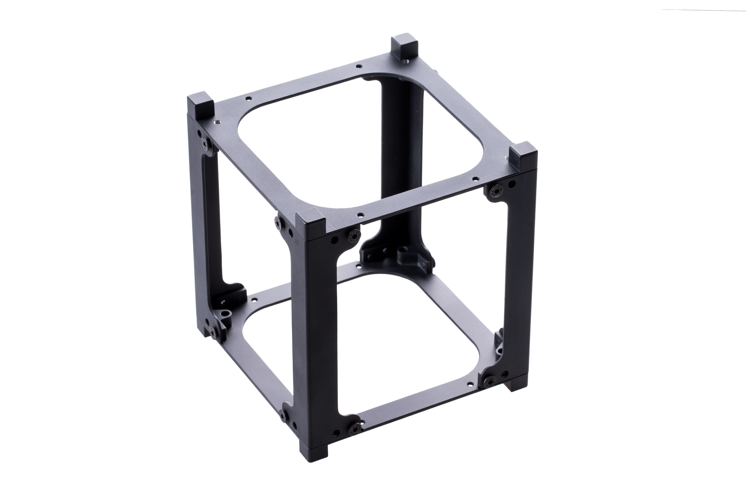
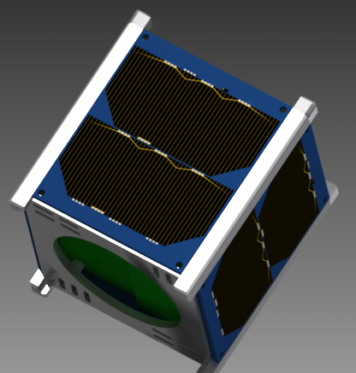
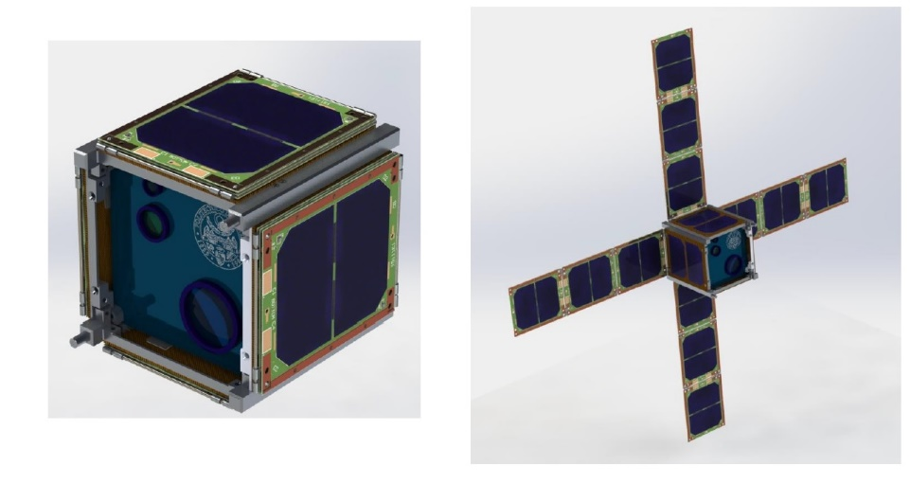
INTRODUCTION to CubeSat
The faces are PCBs
Able to bring on board telescopes, antennas ..
Power consumption

Slide 4
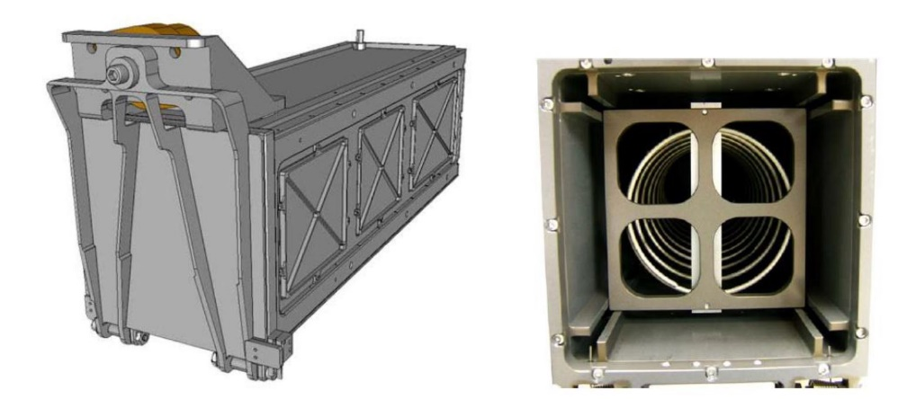
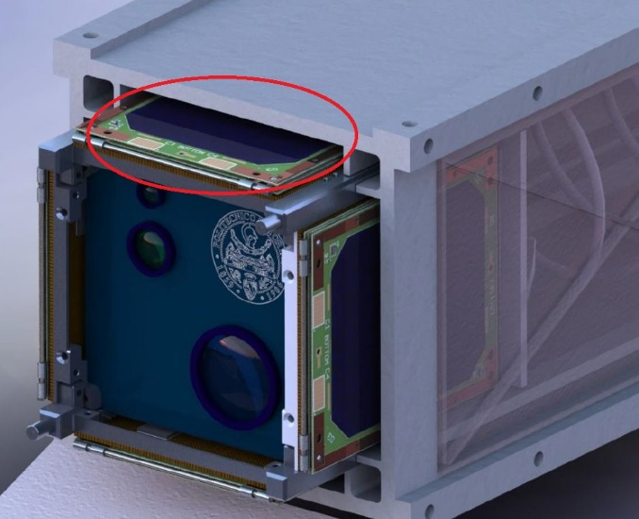
INTRODUCTION to P-POD module
After the passing of the atmosphere the CubeSate is ejected from the P-POD module
After the expulsion the Solar Panels’ Structure should be deployed

Slide 5
Deployable Solar Panels’ Structure
Three tiles due to the P-POD compatibility
Different configurations
Two solar panels for each side of a tile
Two hinges are used to attach the structure to the CubeSate
Each tile is connected to the following one thanks to flexible cable

Slide 6
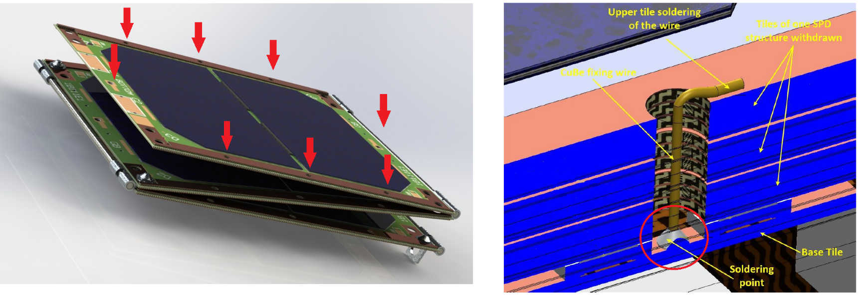
Deploying mechanism
Mechanical springs
Eight CuBe wires to avoid vibrations
Soldering with low melting temperature: 160°C
Deploying mechanism : desoldering of the wires

Slide 7
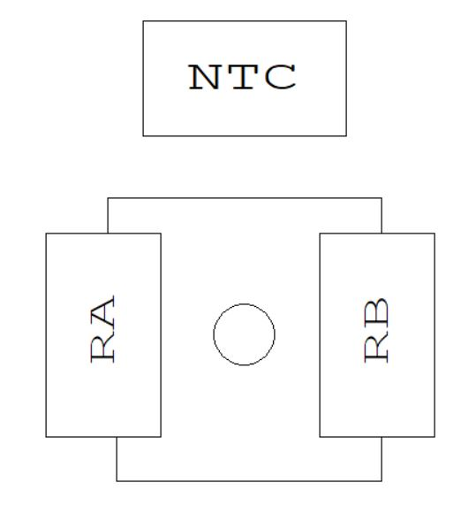
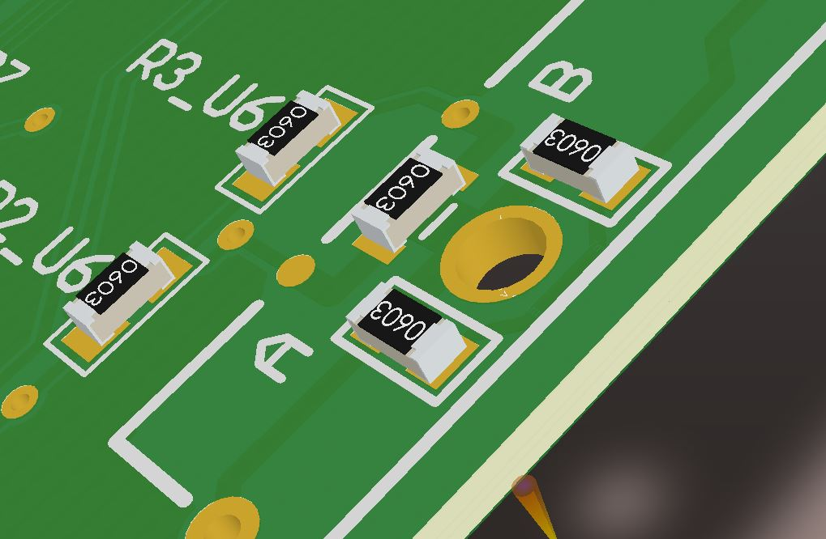
Deploying mechanism
Two resistances to produce heat
Temperature sensor

Slide 8
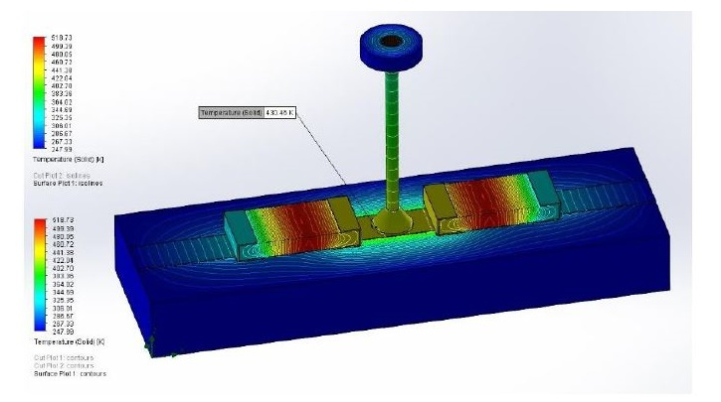
Deploying mechanism
- Thermal analysis : P = 1.5 W
$$P=V ∙ I_{min} ⇒ I_{min}= \frac{P}{V}= \frac{1.5 W}{14 V}=107 mA$$
$$P=R ∙ I_{min} ⇒ R= \frac{P}{I_{min}}= \frac{1.5 W}{107 mA}=131 Ω$$
Two possible configurations: Series and Parallel

Slide 9
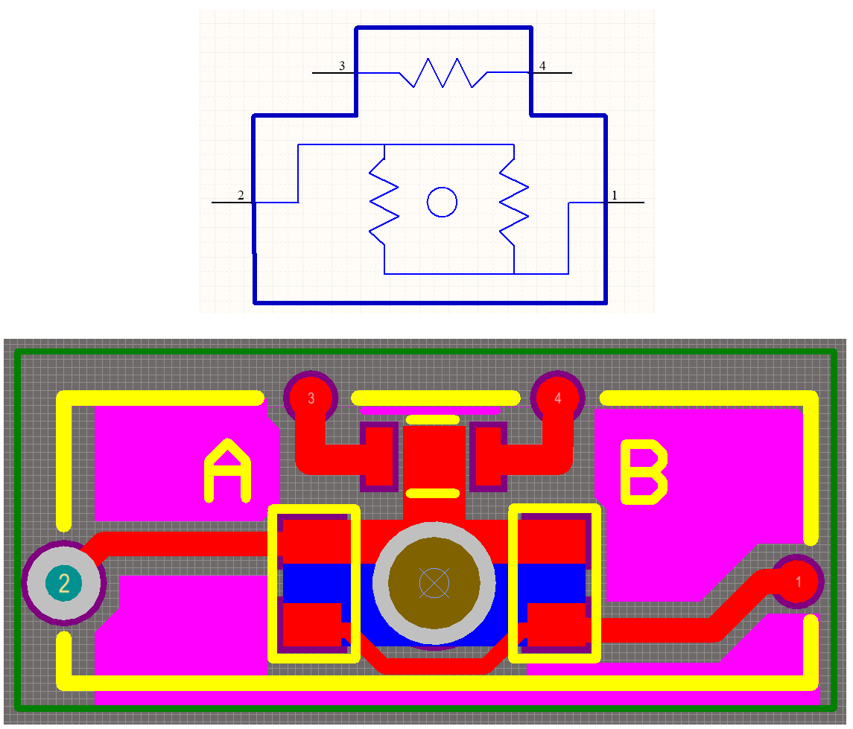
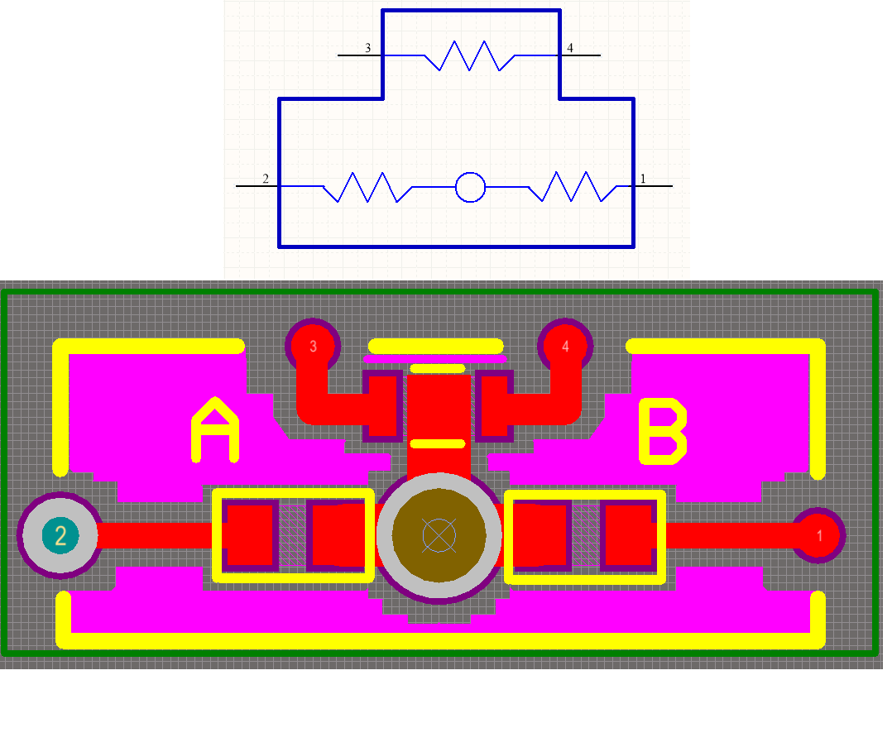
Deploying mechanism
THERMAL FUSER
Thermal fuser series
Thermal fuser parallel
NTC
Resistance
Resistance
Resistances close to the wire
Trace under the NTC
Keepout layer

Slide 10
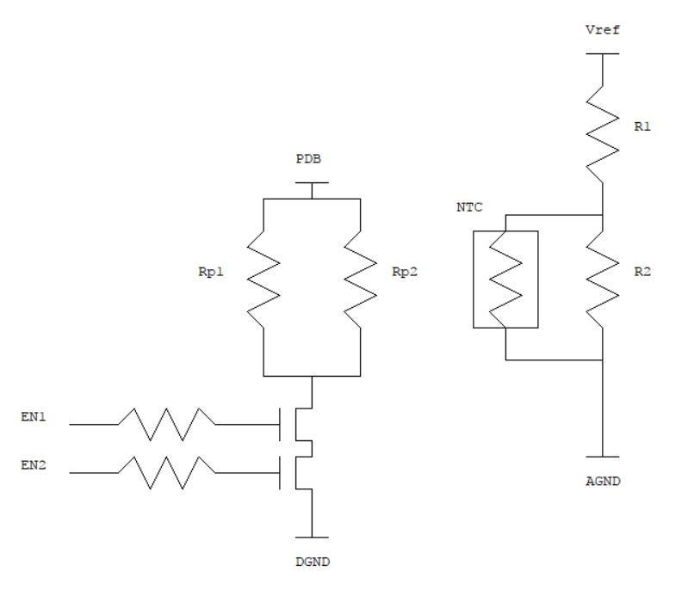
Deploying mechanism
Drive circuit
Temperature feedback control

Slide 11
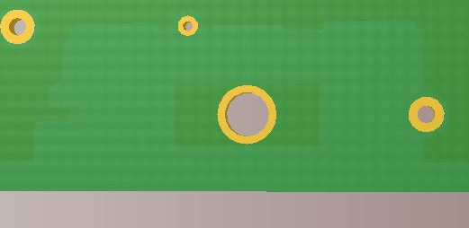
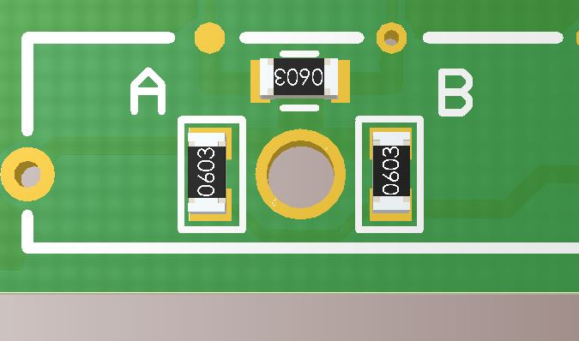
Test Board
Test Board dimensions : 98x82.6 mm
Four layers
0603 packages

Slide 12
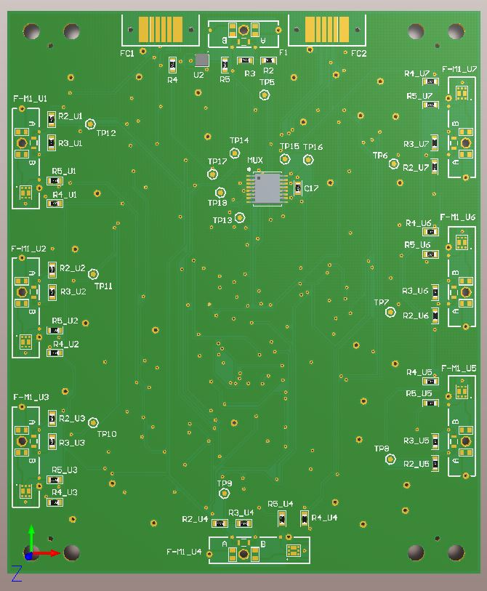
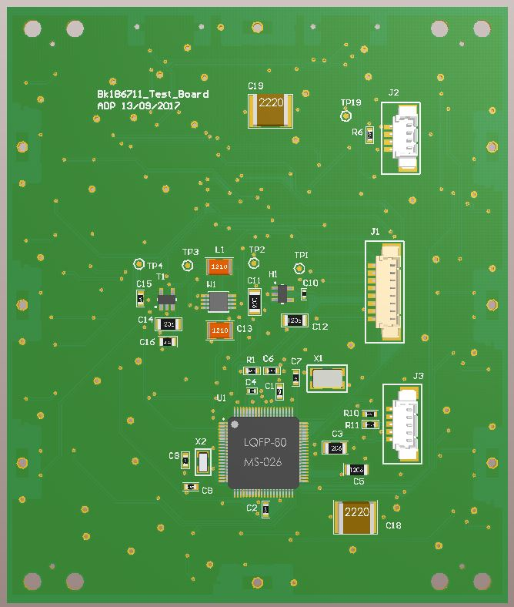
Test Board
Thermal fusers with and without MOS
Positioning of components
Eight holes
3D TOP LAYER
3D BOTTOM LAYER

Slide 13
Test Board
Thermal fusers with and without MOS
Positioning of components
Eight holes
3D TOP LAYER
3D BOTTOM LAYER

Slide 14
Test Board
Thermal fusers with and without MOS
Positioning of components
Eight holes
3D TOP LAYER
3D BOTTOM LAYER

Slide 15
Test Board
Thermal fusers with and without MOS
Positioning of components
Eight holes
3D TOP LAYER
3D BOTTOM LAYER

Slide 16
Test Board
Thermal fusers with and without MOS
Positioning of components
Eight holes
3D TOP LAYER
3D BOTTOM LAYER

Slide 17
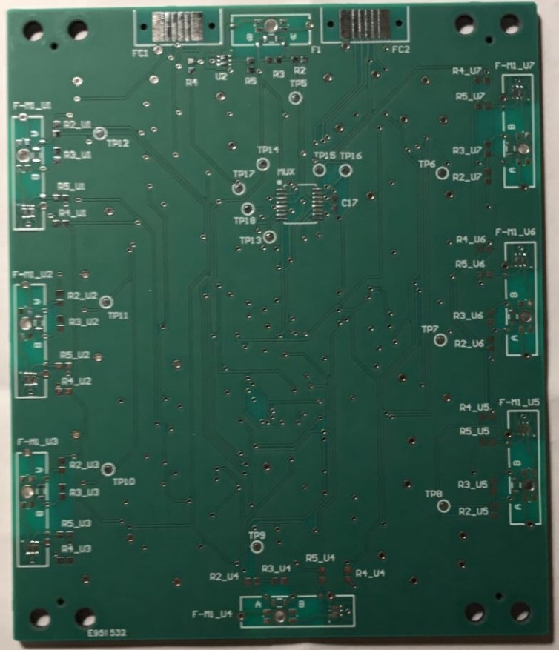
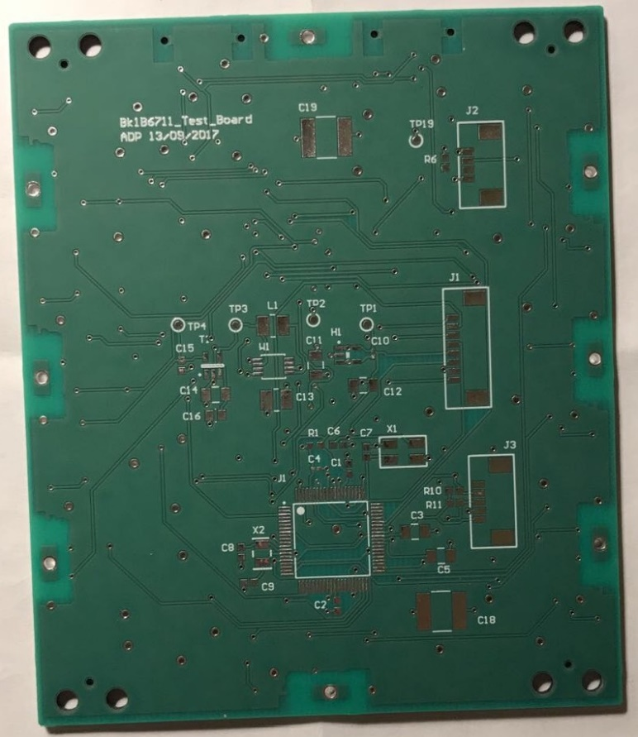
Test Board
REAL TOP LAYER
REAL BOTTOM LAYER

Slide 18
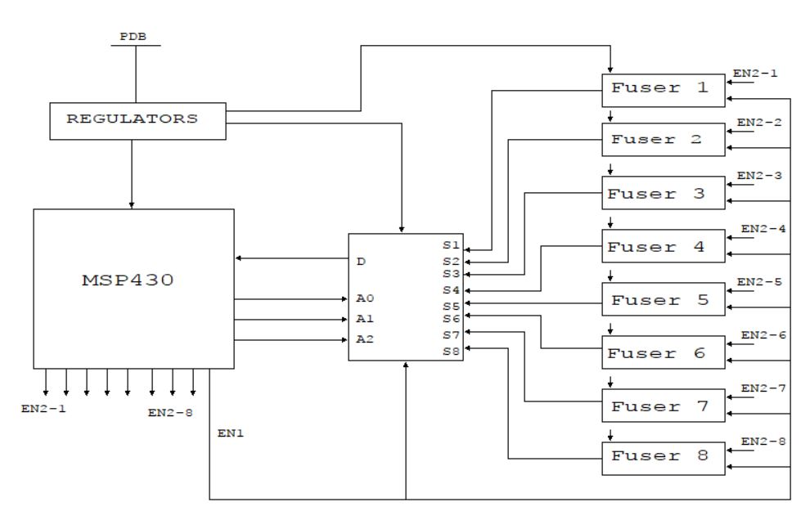
Test Board
Board to test the deploying mechanism
Voltage regulators : 3.3V – 3V – 5V
Microcontroller : MSP430
Multiplexer

Slide 19
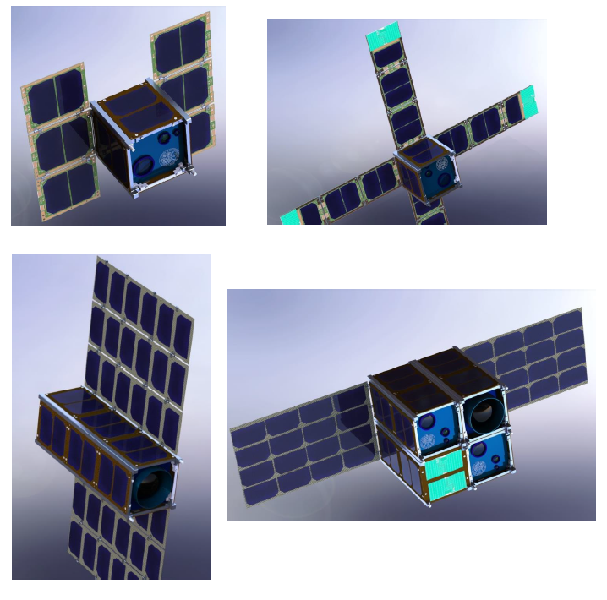
Conclusion
Innovative deploying mechanism
Lowest impact on weight and cost
Versatility

Slide 20
THANKS FOR YOUR ATTENTION

