Slide 1
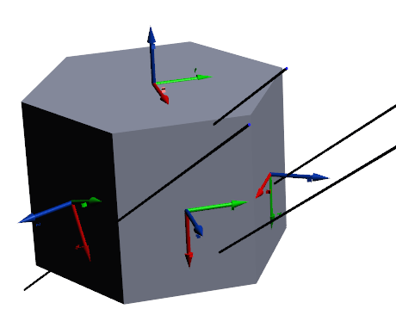
Preparing…
Click on all icons

Slide 2
Attitude and Orbit Determination and Control of Small Satellites
Politecnico di Torino
Electronics Department
Space Avionics Technology Center
Leonardo M. Reyneri
Politecnico di Torino
Electronics Department

Slide 3
PART I
Satellite Orbits and Localization

Slide 4
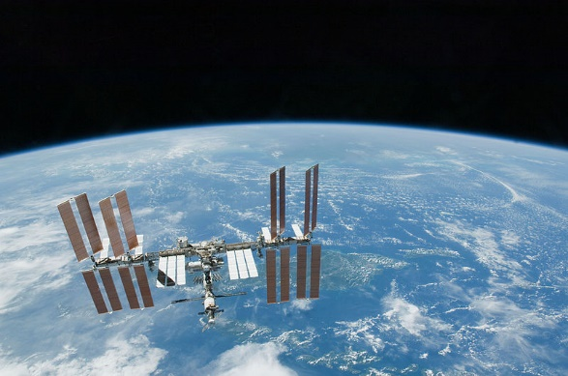
Spacecraft Orbits
Int’l Space Station (ISS) orbiting Earth
By NASA - http://spaceflight.nasa.gov/gallery/images/shuttle/sts-130/html/s130e012142.html, Public Domain, https://commons.wikimedia.org/w/index.php?curid=9537591

Slide 5
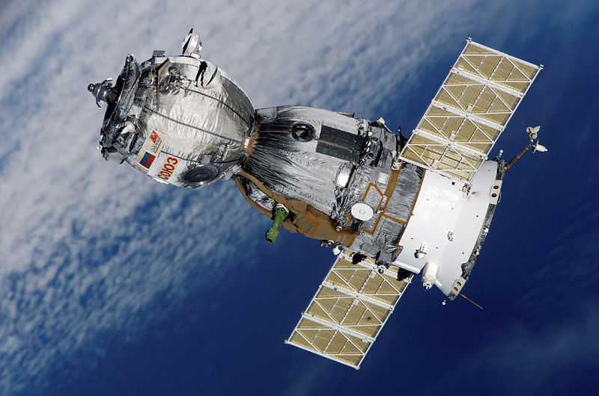
Spacecraft Orbits
Soyuz TMA-7 orbiting Earth
By The original uploader was Thegreenj at English Wikipedia - Transferred from en.wikipedia to Commons., Public Domain, https://commons.wikimedia.org/w/index.php?curid=2726282

Slide 6
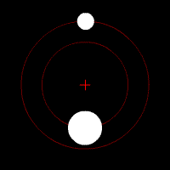
Spacecraft Orbits
Two bodies of different mass orbiting a common barycenter
By User:Zhatt - Own work, Public Domain, https://commons.wikimedia.org/w/index.php?curid=280053

Slide 7
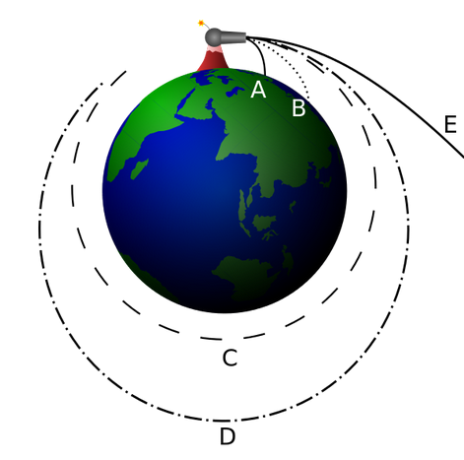
Spacecraft Orbits
Newton's cannonball – how speed affects orbit:
A,B: too slow!
C: critical speed
D: elliptical
E: too fast!
By user:Brian Brondel - Own work, CC BY-SA 3.0, https://commons.wikimedia.org/w/index.php?curid=1657849

Slide 8
Circular Orbit
$F_{V}=M_{S}\frac{V^{2}}{R}$
$F_{G}=G\frac{M_{E}M_{S}}{R^{2}}$
$F_{G}=F_{V}$ (equilibrium)
$G\frac{M_{E}M_{S}}{R^{2}}=M_{S}\frac{V^{2}}{R}$
$G \frac{M_{E}}{R}=V^{2}$
Fv
V
Ms
Fg
R
Me
$$V=\sqrt{\frac{{GM}_{E}}{R}}$$
$$T=\frac{2πR}{V}$$

Slide 9
Circular Orbit
NO gravity!
Fv
V
$$R=R_{E}+h$$
$$R_{E}=\text{6356.8 }\text{km}$$
Fg
R
Re
h

Slide 10
Circular Orbit
$M_{E}=\text{5.972 }\text{x} {10}^{24} \text{kg}$
$M_{E}=\text{5.972 }\text{E}\text{24 }\text{kg}$
$G=\text{6.674 }\text{E}\text{−11 }\text{m}\text{3} \text{kg}\text{−1} \text{s}\text{−2}$
$R=R_{E}+h$
$R_{E}=\text{6356.8 }\text{km}$
$h=\text{600} \text{km}$
$V=\sqrt{\frac{{GM}_{E}}{R}}$
V
Re
h
Me
$=7.57 km/s$ !!!

Slide 11
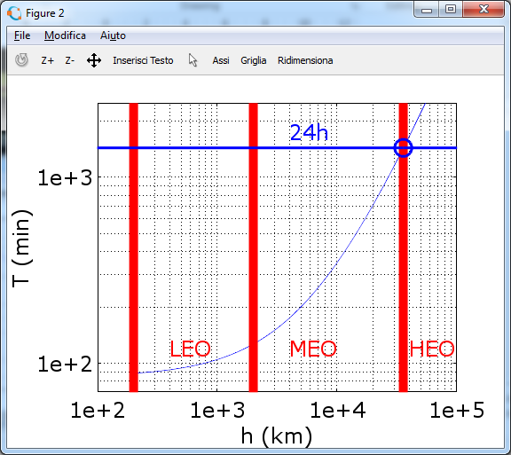
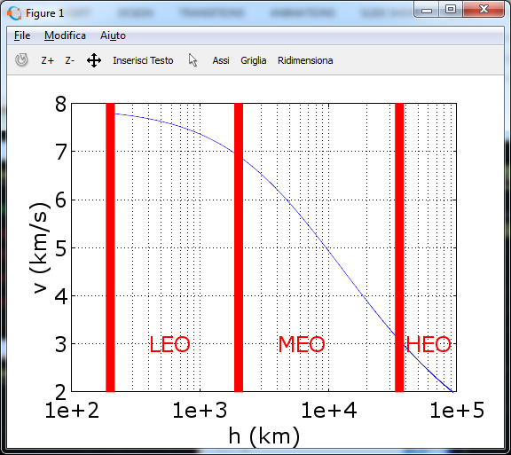
Circular Orbit
(23 h 56 min 4 s)
GEO
Low Earth Orbit
(200-2000) km
Medium Earth Orbit (2000-35,786) km
High Earth Orbit
> 35,786 km

Slide 12
Elliptical Orbit
$$V(t)=\sqrt{{GM}_{E}\left(\frac{2}{R(t)}−\frac{2}{A}\right)}$$
For circular ($R=\frac{A}{2}$):
$$V=\sqrt{{GM}_{E}\frac{1}{R}}$$
perigee
Ms
V
R
Me
A
apogee

Slide 13
Orbital params (Keplerian elements)
Perigee/periapsis $R_{P}$
Apogee/apoapsis $R_{A}$
Eccentricity:
$$e=\frac{R_{A}−R_{P}}{R_{A}+R_{P}}$$
2) Semi-major axis:
$a=\frac{A}{2}=\frac{R_{A}+R_{P}}{2}$
Rp
A
Ra

Slide 14
Orbital params (Keplerian elements)
Reference plane: Earth Equatorial plane
Reference direction: First Point of Aries
1) Eccentricity e
2) Semi-major axis a
By Lasunncty at the English language Wikipedia, CC BY-SA 3.0, https://commons.wikimedia.org/w/index.php?curid=8971052

Slide 15
Orbital params (Keplerian elements)
3) Inclination $i$ w.r.t. Reference plane
4) Longitude of ascending node $Ω$ w.r.t. Reference direction
5) Argument of perigee $ω$ w.r.t. Ascending node

Slide 16
Orbital params (Keplerian elements)
6) True anomaly $υ$ w.r.t. perigee.
It is the only time-varying element!

Slide 17
Orbit Inclinations
Equatorial: inclination $≈0$
Polar Prograde: inclination $≈90°$ but $<90°$
Polar Retrograde: inclination $≈90°$ but $>90°$
Equatorial Retrograde: inclination $≈180°$
Sun Synchronous: polar retrograde (around $98°$) such that the satellite passes over any given point of the planet's surface at the same local solar time.

Slide 18
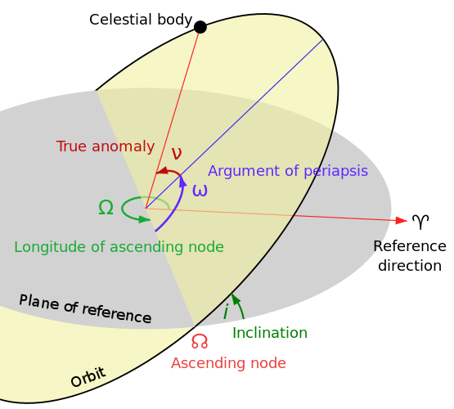
Orbital manoeuvres
Change orbit altitude $h$ and/or eccentricity $e$
Change orbital plane ($i$, $Ω$, $ω$)
Formation flight: very frequent (or continuous) very little manoeuvres to keep relative distance w.r.t. another spacecraft. It is very much mission-dependent
V
Re
h

Slide 19
Circular ➔ Elliptical Orbit
Start from circular ($R$, $V_{0}$)
$$V_{0}=\sqrt{\frac{{GM}_{E}}{R}}$$
Then apply $∆V$ such as:
$$V=V_{0}+∆V=\sqrt{{GM}_{E}\left(\frac{2}{R}−\frac{2}{A}\right)}$$
$$A=\frac{2}{\frac{2}{R}−\frac{{\left(V_{0}+∆V\right)}^{2}}{{GM}_{E}}}>2R$$
$$V_{0}+∆V$$
$$V_{0}$$
R
Me
A
V1

Slide 20
Circular ➔ Elliptical Orbit
$$V_{0}=\sqrt{\frac{{GM}_{E}}{R}}$$
$$A=\frac{2}{\frac{2}{R}−\frac{{\left(\sqrt{\frac{{GM}_{E}}{R}}+∆V\right)}^{2}}{{GM}_{E}}}$$
$$A=\frac{2R}{2−{\left(1+\sqrt{\frac{R}{{GM}_{E}}}∆V\right)}^{2}}$$
For ΔV=0, it remains circular:
$$A=\frac{2R}{2−1}=2R$$
Vo+ΔV
R
Me
A*
V1

Slide 21
Elliptical ➔ Circular Orbit
Apply another $∆V$ such that:
$$V_{1}+∆V=\sqrt{\frac{{GM}_{E}}{R^{∗}=R_{A}}}$$
Orbit returns circular!
BUT, we have changed orbit radius!
R*
Me
$$R_{A}$$
V1
V1+ΔV

Slide 22
Formation Flight
Formation flight = mantaining a constant relative position among a set of spacecraft.
Many alternatives. A few cases:
Along same orbit (in sequence on the same orbit). In theory the simplest, but…
Along same orbital radius (same orbital period, different altitudes)
Along parallel orbits (same orbital period, same altitude)

Slide 23
Formation Flight
h2
Re
h1
Me

Slide 24
Formation Flight
$$\begin{matrix}F_{V1}=M_{S}ω^{2}R_{1} & F_{V2}=M_{S}ω^{2}R_{2} \\ F_{G1}=G\frac{M_{E}M_{S}}{R_{1}^{2}} & F_{G2}=G\frac{M_{E}M_{S}}{R_{2}^{2}} \\ G\frac{M_{E}M_{S}}{R_{1}^{2}}=M_{S}ω^{2}R_{1} & G\frac{M_{E}M_{S}}{R_{2}^{2}}=M_{S}ω^{2}R_{2}+F\end{matrix}$$
$$F=3∆R \frac{GM_{E}M_{S}}{R_{1}^{3}}$$
$$M_{S}∆V=FT=3∆R \frac{GM_{E}M_{S}}{R_{1}^{3}}T$$

Slide 25
Propulsion
Problem: we have to apply a $∆V$. How ?
Newton’s laws:
Preservation of momentum: if $F=0$: $M∗V$ = const if $F=0$: $M_{1}V_{1}+M_{2}V_{2}+M_{3}V_{3}+$… = const if $F=0$: $M_{1}∆V_{1}+M_{2}∆V_{2}$ = 0
Force Impulse: if we apply $F≠0$ for $T>0$: $M∗∆V=F∗T$

Slide 26
`Propulsion
How to apply a $∆V$ ?
Must apply a single force $F≠0.$Requires either:
A “fixed point” from which to apply a momentum $M_{S}∗∆V$(i.e. to exert a force $F$ for a given time $T$):
$$F∗T=M_{S}∗∆V$$
Find a source of «pressure» $P$on a «sail» of surface $S$ (e.g. solar light)
$$(P∗S)∗T=M_{S}∗∆V$$

Slide 27
Orbital Manoeuvres
Ejecting mass $M_{G}$(usually a gas) at a high speed (from 0 to ${−V}_{G}$) to preserve total momentum:
$$−M_{G}∗V_{G}+M_{S}∗∆V=0$$
$$M_{G}=\frac{M_{S}∗∆V}{V_{G}}$$
Gas speed$V_{G}$ is usually expressed by means of the “specific impulse” (seconds)
$$V_{G}=I∗g$$
$$g=(9.81m/{s^{2}})$$

Slide 28
An Exercise - I
Given a spacecraft with mass $M_{S}=5kg$ on circular LEO with altitude $h=600km$
Compute spacecraft speed $v$
Compute orbit period $T$
Compute ${∆V}_{1}$ to transfer spacecraft into an elliptical orbit with apogee altitude $h_{2}=1000km$
Compute ${∆V}_{2}$ to transfer spacecraft into an circular orbit with altitude $h_{2}=1000km$

Slide 29
Answers - I
Spacecraft speed $v=7.57{km}/s$
Orbit period $T=96.25min$
First orbit manoeuvre ${∆V}_{1}=105m/s$
Second orbit manoeuvre ${∆V}_{2}=103.6m/s$

Slide 30
An Exercise - II
Compute time $T_{F}$ to achieve ${∆V}_{1}=105m/s$ using only solar pressure $P= \frac{K_{S}}{c}$ ($K_{S}=1360W/{m^{2}}$) on a sail of $S=1m^{2}$
Compute gas mass $M_{G}$ to achieve ${∆V}_{1}=105m/s$ knowing gas speed $V_{G}=1000m/s$ ($I=102s$)
Compute $∆V$ to maintain formation flight with $∆R=1m$ at $600km$ altitude for $3 months$ mission duration

Slide 31
Answers - II
Time $T_{F}=3.6y$
Gas mass $M_{G}=525g$
Required $∆V=138m/s$

Slide 32
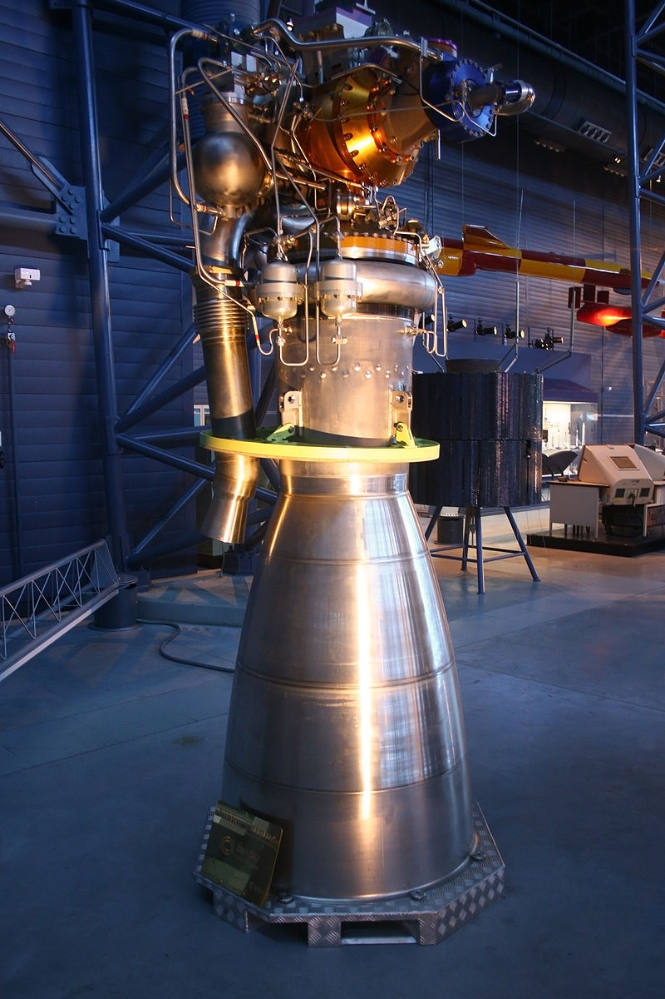
Thrusters
Rockets
Specific impulse $$I=200÷500s$$
Viking 5C rocket engine
By Sanjay Acharya - Own work, CC BY-SA 3.0, https://commons.wikimedia.org/w/index.php?curid=4293802

Slide 33
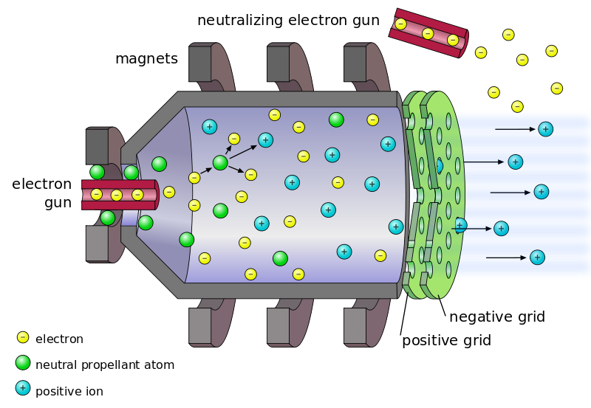
Thrusters
Gridded ion thrusters
Specific impulse $I=10000s$
By Oona Räisänen - Own work; self made in Inkscape. Based on File:Ion_engine.gif., CC BY-SA 3.0, https://commons.wikimedia.org/w/index.php?curid=20308289

Slide 34
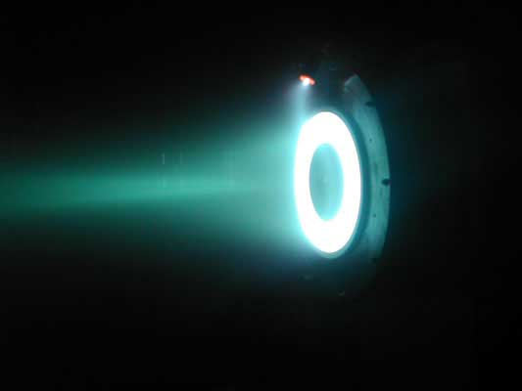
Thrusters
Hall-effect thrusters
Specific impulse $I=1000÷3000(8000)s$
By Dstaack at English Wikipedia - Transferred from en.wikipedia to Commons., Public Domain, https://commons.wikimedia.org/w/index.php?curid=2137404

Slide 35
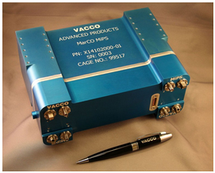
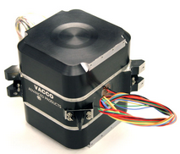
Thrusters
Cold Gas thrusters
Specific impulse $I=20÷80s$
http://www.cubesat-propulsion.com/jpl-marco-micro-propulsion-system/
http://www.cubesat-propulsion.com/reaction-control-propulsion-module/

Slide 36
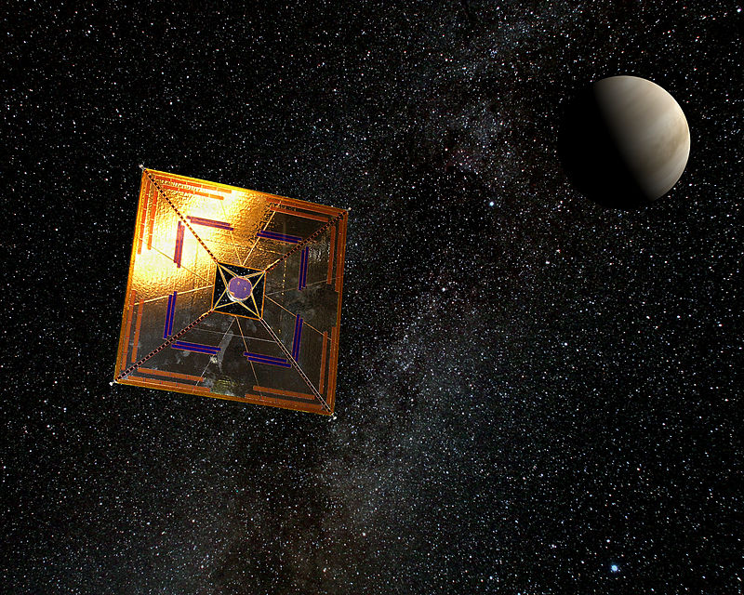
Solar Sails
IKAROS spaceprobe
14m x 14m solar sail
2kg mass
1mN thrust
By Andrzej Mirecki - Own work, CC BY-SA 3.0, https://commons.wikimedia.org/w/index.php?curid=14656159

Slide 37
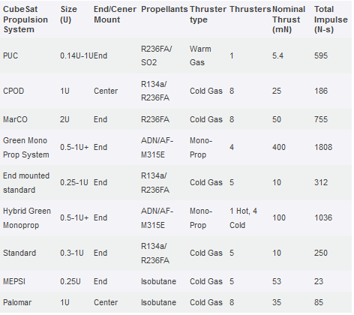
Thrusters for CubeSats
$$MΔV$$
http://www.cubesat-propulsion.com/vacco-systems/

Slide 38
Center Of Gravity (C.O.G.)
What point of a spacecraft exactly remains on the orbit and exactly follows the rules of gravity?
The so-called CENTER OF GRAVITY (C.O.G.)
The most important points for orbit and attitude evaluation and control !!!
It is very important to be able to compute its position on-board spacecraft

Slide 39
Center Of Gravity (C.O.G.)
C.O.G. is a point C; it has coordinates (X,Y,Z) w.r.t. geometrical center of satellite.
Each coordinate (X/Y/Z) is the weighted mean of the corresponding coordinate of each subsystem:
$$C_{X}=\frac{M_{1}∗X_{1}+M_{2}∗X_{2}+…+M_{N}∗X_{N}}{M_{1}+M_{2}+…+M_{N}}$$
$$C_{Y}=\frac{M_{1}∗Y_{1}+M_{2}∗Y_{2}+…+M_{N}∗Y_{N}}{M_{1}+M_{2}+…+M_{N}}$$
$$C_{Z}=\frac{M_{1}∗Z_{1}+M_{2}∗Z_{2}+…+M_{N}∗Z_{N}}{M_{1}+M_{2}+…+M_{N}}$$

Slide 40
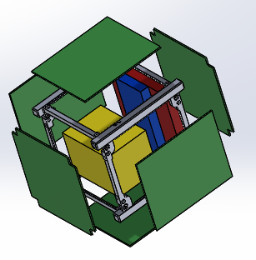
An Exercise - III
Imagine a 1U CubeSat (10cmx10cmx10cm) with:
six walls of 100g each located 5cm from geometrical center
One power supply unit of 150g located at coordinate (0,0,+4cm) w.r.t. geometrical center
One on-board computer of 80g located at coordinate (0,0,+3cm) w.r.t. geometrical center
One payload of 250g located at coordinate (1cm,-2cm,-1cm) w.r.t. geometrical center
What is the total mass and where is located C.O.G. ?

Slide 41
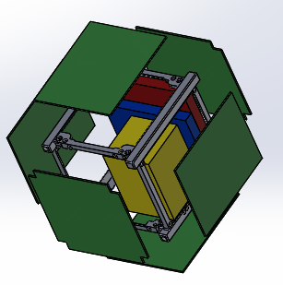

Slide 42
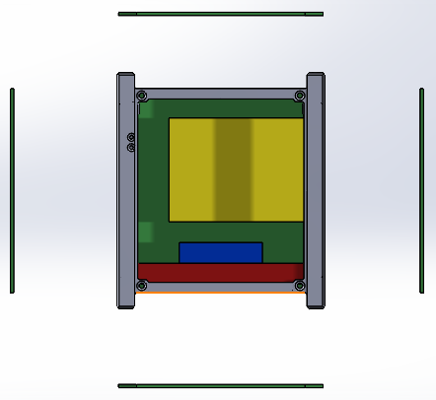

Slide 43
An Exercise - III
Lateral panels:
W1: 100g (0,0,+5cm)
W2: 100g (0,0,-5cm)
W3, W4…

Slide 44
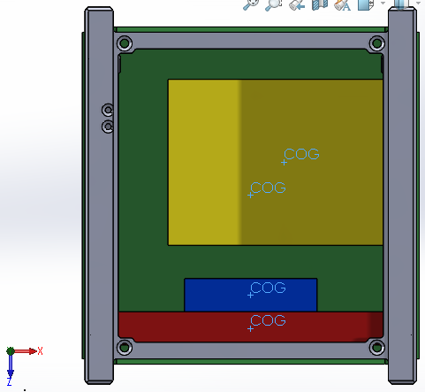
X
Z

Slide 45
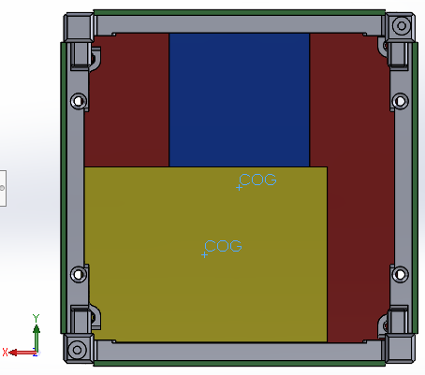
Y
X

Slide 46
An Exercise - III
Lateral panels:
W1: 100g (0,0,+5cm)
W2: 100g (0,0,-5cm)
W3, W4… 100g (…,…,…)
Other subsystems:
Power supply: 150g (0,0,+4cm)
OBC: 80g (0,0,+3cm)
Payload: 250g (1cm,-2cm,-1cm)
$$C_{X}=\frac{M_{1}∗X_{1}+M_{2}∗X_{2}+…+M_{N}∗X_{N}}{M_{1}+M_{2}+…+M_{N}}$$

Slide 47
Answers III
Total mass is $1080g$
C.O.G. is located at (0.23cm,-0.46cm,+0.55cm)

Slide 48
Satellite Position and Orbit
Spacecraft Position $P(t)$ is position of center of gravity at any given instant $t$
Spacecraft Orbit $O$ is the set of all consecutive positions $P(t)∈O$ and is independent of time
In reality spacecraft orbit $O$ slowly varies with time because of several perturbations
P(t)
Earth
O
48

Slide 49
Effects of Position in Orbit
Day & night…
P(t)
Earth
SUN
O

Slide 50
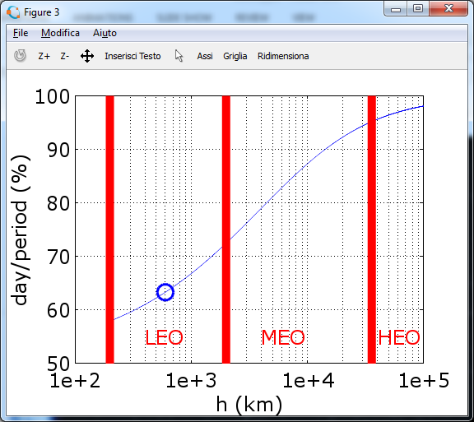
Effects of Position in Orbit

Slide 51
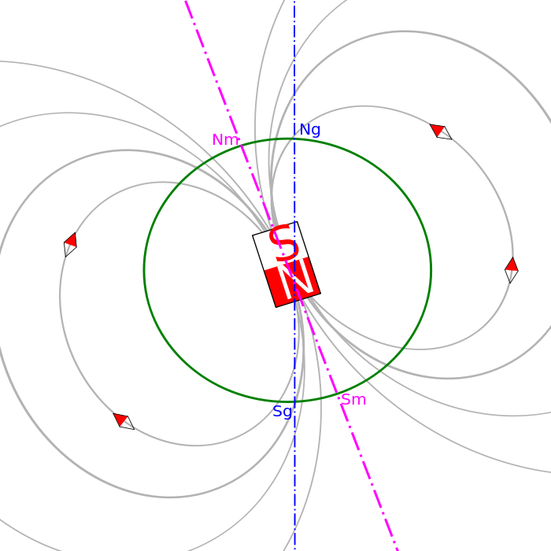
Effects of Position in Orbit
Magnetic field…
P(t)
O

Slide 52
Effects of Position in Orbit
Magnetic field…

Slide 53
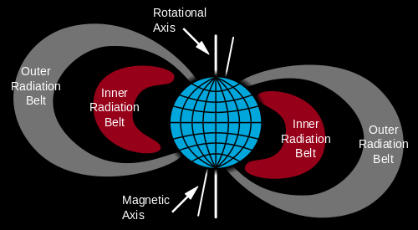
Effects of orbit altitude
Van Hallen Belts are two zones of energetic charged particles, most of which originate from the solar wind that is captured by and held around Earth by its magnetic field.
By Booyabazooka at English Wikipedia - Transferred from en.wikipedia to Commons., Public Domain, https://commons.wikimedia.org/w/index.php?curid=1715297

Slide 54
Effects of orbit altitude
Van Hallen Belts extend from an altitude of about 500 to 58,000 kilometers above the surface in which region radiation levels vary.
By Booyabazooka at English Wikipedia - Transferred from en.wikipedia to Commons., Public Domain, https://commons.wikimedia.org/w/index.php?curid=1715297

Slide 55
Effects of orbit altitude
By trapping the solar wind, the magnetic field deflects those energetic particles and protects the Earth's atmosphere from destruction.
The belts trap energetic electrons and protons. Other nuclei (e.g. alpha particles) are less prevalent.
BUT…
The belts endanger satellites, which must have their sensitive components protected with adequate shielding if they spend significant time in that zone.

Slide 56
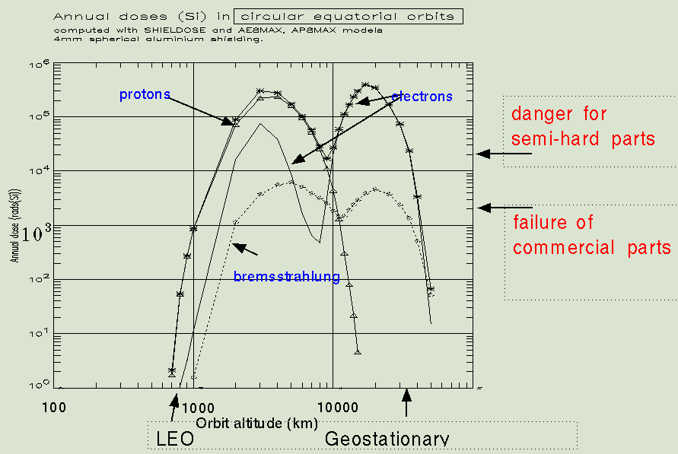
Effects of orbit altitude

Slide 57
Spacecraft Localization
NORAD (North American Aerospace Defense Command)
Tracks (by radar) every object in space every few days
Returns «TLEs» containing measured orbital parameters

Slide 58
Spacecraft Localization
From measured orbital parameters each spacecraft shall predict orbit for the following days until next NORAD update
NORAD
CONTROL CENTER
GROUND STATION
ON-BOARD
PREDICTOR
SPACE CRAFT

Slide 59
PART II
Spacecraft Attitude

Slide 60
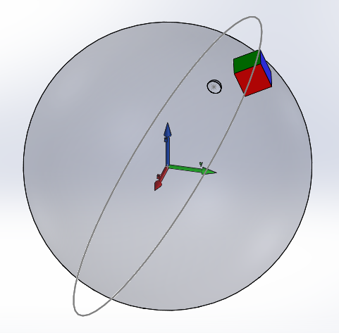
Reference Frames
Earth-Centered Inertial Frame (ECI)
$$F_{E}$$
Z=Earth Rotation Axis
Orthogonal
$$(Y=Z×X)$$
X=Vernal Point
XY plane is equatore

Slide 61
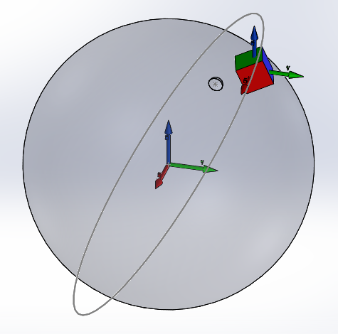
Reference Frames
$$Z′∥Z$$
Sat-Centered Inertial Frame (SCI)
$$F_{S}$$
O is C.O.G.
$$Y′∥Y$$
$$X′∥X$$

Slide 62
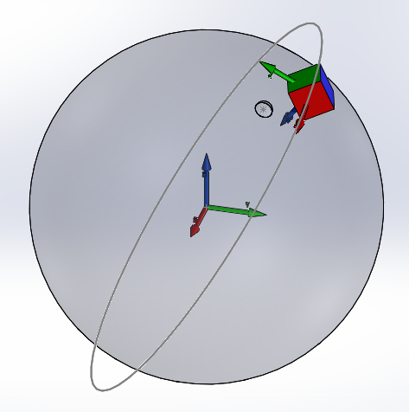
Reference Frames
$Y′$ is orthogonal to orbit
O’ is C.O.G.
Orbital Frame
(not very useful for us…)
$Z′$ is nadir
Orthogonal
$$(X′=Y′×Z′)$$

Slide 63
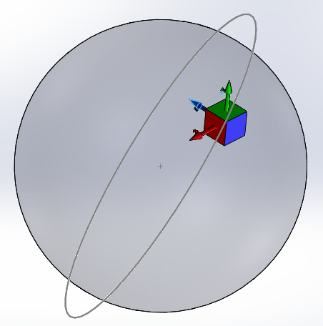
Reference Frames
$Y′$ may be antenna principal direction.
Must be normal to $Z′$
Body-Fixed Frame
$$F_{B}$$
$X′$, $Y′$, $Z′$ are pre-defined relevant directions for spacecraft
Z$′$ may be heading direction for telescope
O is C.O.G.
Orthogonal
$$(X′=Y′×Z′)$$

Slide 64
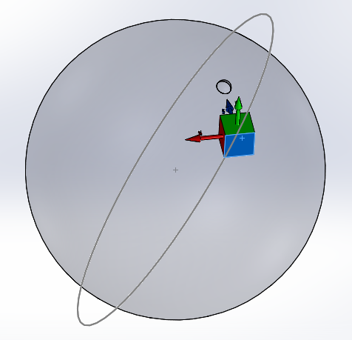
Reference Frames
Target-Pointing Frame
$$F_{T}$$
Z$′$ always aims at desired target
O’ is C.O.G.
$X′$ is parallel to equator
Orthogonal
$$(Y′=Z′×X′)$$

Slide 65
Reference Frames
ECI + Sat-Centered

Slide 66
Reference Frames
ECI + Orbit

Slide 67
Reference Frames
ECI + Body-Fixed

Slide 68
Reference Frames
All frames…

Slide 69
Attitude
Spacecraft Attitude is defined as the ROTATION from
Spacecraft Centered Inertial Frame $F_{S}$ to
Body-Fixed Frame $F_{B}$
We have to define rotations (attitudes et al.) mathematically:
Euler Angles
Axis + Angle
Rotation Matrix
Quaternion

Slide 70
Euler Angles
ANY orientation can be achieved by composing three elemental rotations, i.e. rotations about the axes of a coordinate system.
Euler angles can be defined by three of these rotations.

Slide 71
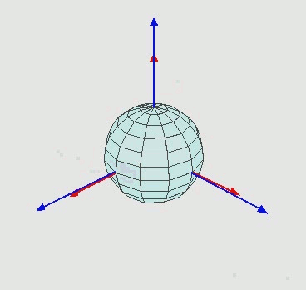
Euler Angles
Euler angles:
z-x-z
Other Euler angles are:
x-y-x
y-z-y
z-y-z
x-z-x
y-x-y
Z
X
Y
By Euler2.gif: Juansemperederivative work: Xavax - This file was derived from Euler2.gif:, CC BY-SA 3.0, https://commons.wikimedia.org/w/index.php?curid=24338647

Slide 72
Axis + Angle
Euler's rotation theorem states that, in 3-D, any displacement of a rigid body such that a point on the rigid body remains fixed (C.O.G. in our case),
is equivalent to
a single rotation by some angle about some axis that runs through the fixed point.
It also states that the composition of two rotations around the same point (C.O.G. in our case) is also a rotation.

Slide 73
Axis + Angle
By DF Malan - Own work, Public Domain, https://commons.wikimedia.org/w/index.php?curid=1354297

Slide 74
Rotation Matrix
Orthogonal axes (e.g. Sat-Centered Inertial) can be expressed as 3-D vectors:
$$\begin{matrix}X=\left(\begin{matrix}1 \\ 0 \\ 0\end{matrix}\right) & Y=\left(\begin{matrix}0 \\ 1 \\ 0\end{matrix}\right) & Z=\left(\begin{matrix}0 \\ 0 \\ 1\end{matrix}\right)\end{matrix}$$
Or, altogether, as a matrix:
$$F_{S}=XYZ=\begin{matrix}\left(\begin{matrix}1 \\ 0 \\ 0\end{matrix}\right) & \left(\begin{matrix}0 \\ 1 \\ 0\end{matrix}\right) & \left(\begin{matrix}0 \\ 0 \\ 1\end{matrix}\right)\end{matrix}=\left(\begin{matrix}\begin{matrix}1 \\ 0 \\ 0\end{matrix} & \begin{matrix}0 \\ 1 \\ 0\end{matrix} & \begin{matrix}0 \\ 0 \\ 1\end{matrix}\end{matrix}\right)$$

Slide 75
Rotation Matrix
Axes are mutually orthogonal as their mutial dot products are null:
$$\begin{matrix}X∗Y=0 & X∗Z=0 & Z∗Y=0\end{matrix}$$
$$\left(\begin{matrix}1 \\ 0 \\ 0\end{matrix}\right)∗\left(\begin{matrix}0 \\ 1 \\ 0\end{matrix}\right)=1∗0+0∗1+0∗0=0$$
Axes are also unit-length as their norm is unity:
$$\begin{matrix}X∗X=1 & Y∗Y=1 & Z∗Z=1\end{matrix}$$

Slide 76
Rotation Matrix
Axes of rotated frames X’Y’Z’ (e.g. Body-Fixed) can also be expressed as three 3-D vectors.
For instance:
$$\begin{matrix}X′=\left(\begin{matrix}\text{0.959} \\ \text{−0.1}\text{10} \\ \text{−0.260}\end{matrix}\right) & Y′=\left(\begin{matrix}\text{0.142} \\ \text{0.98}\text{4} \\ \text{0.1}\text{10}\end{matrix}\right) & Z′=\left(\begin{matrix}\text{0.244} \\ \text{−0.142} \\ \text{0.959}\end{matrix}\right)\end{matrix}$$
Or again as a matrix:
$$F_{B}=XYZ′=\left(\begin{matrix}\begin{matrix}\text{0.959} & \text{0.142} & \text{0.244}\end{matrix} \\ \begin{matrix}\text{−0.1}\text{10} & \text{0.98}\text{4} & \text{−0.142}\end{matrix} \\ \begin{matrix}\text{−0.260} & \text{0.1}\text{10} & \text{0.959}\end{matrix}\end{matrix}\right)$$

Slide 77
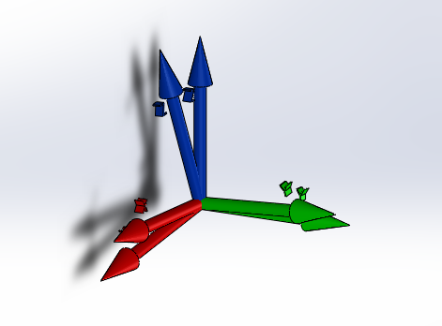
Rotation Matrix
$$XYZ′=\left(\begin{matrix}\begin{matrix}\text{0.959} & \text{0.142} & \text{0.244}\end{matrix} \\ \begin{matrix}\text{−0.1}\text{10} & \text{0.98}\text{4} & \text{−0.142}\end{matrix} \\ \begin{matrix}\text{−0.260} & \text{0.1}\text{10} & \text{0.959}\end{matrix}\end{matrix}\right)$$

Slide 78
Rotation Matrix
Axes are again mutually orthogonal as their dot products are null:
$$\begin{matrix}X′∗Y′=0 & X′∗Z′=0 & Z′∗Y′=0\end{matrix}$$
Axes are also unit-length as their norm is unity:
$$\begin{matrix}X′∗X′=1 & Y^{′}∗Y′=1 & Z^{′}∗Z′=1\end{matrix}$$
Try yourself if you do not believe…

Slide 79
Rotation Matrix
A rotation matrix can be derived from rotation axis + angle. From Wikipedia:
Viceversa (from rotation matrix to axis + angle):
rotation axis is the only non-complex eigenvector of the rotation matrix

Slide 80
Quaternion
A quaternion is a more compact expression of a rotation. It is totally equivalent to a rotation axis + angle.
In mathematics, the quaternions are a number system that extends the complex numbers.
Quaternions are represented in the form:
$$a + bi + cj + dk$$
where a, b, c, and d are real numbers, and i, j, k are the fundamental quaternion units

Slide 81
Quaternion
Given a rotation axis and an angle
$R=\left(\begin{matrix}R_{X} \\ R_{Y} \\ R_{Z}\end{matrix}\right)$, $θ$ such that $R∗R=1$
The corresponding quaternion is defined as:
$$Q=\cos\left(θ/2\right)+\left(R_{X}i+R_{Y}j+R_{Z}k\right)∗\sin{(θ/2)}$$

Slide 82
Quaternion
Or, in vector form:
$Q=\left(\begin{matrix}\begin{matrix}cos⁡(θ/2) \\ R_{X}\sin{(θ/2)}\end{matrix} \\ \begin{matrix}R_{Y}\sin{(θ/2)} \\ R_{Z}\sin{(θ/2)}\end{matrix}\end{matrix}\right)$ consequently $Q∗Q=1$
Conversion to/from quaternion and axis+angle is immediate
Conversion to/from quaternion and rotation matrix is similar to conversion between rotation matrix and axis+angle (already seen)

Slide 83
Degrees Of Freedom
In physics, the Degree Of Freedom (DOF) of a mechanical system is the number of independent parameters that define its configuration.
For instance:
A point in 3-D has three DOF (its three coordinates)
A point on a sphere has two DOF (either longitude/latitude or azimut/elevation)
An axis has two DOF (azimut/elevation)

Slide 84
Degrees Of Freedom
A unit-length vector $U$ has two DOF (the third coordinate is obtained by constraint $U∗U=1$)
A rotation has three DOF (axis (2) + angle (1))
A quaternion has three DOF (4 components – 1 constraint $Q∗Q=1$)
A rotation matrix has three DOF:
first 2 coord. of $X$; third one comes from $X∗X=1$;
first coord. of $Y$; 2nd and 3rd come from $X∗Y=0$ and $Y∗Y=1$;
remaining three coord. of $Z$ come from $X∗Z=0$, $Z∗Y=0$, $Z∗Z=1$ !!!

Slide 85
Inverse Rotation
Inverting rotation, with:
Euler angles: invert angles and invert sequence:
$$\left(32°,−12°,47°{12}^{′}\right)⇒\left(−47°{12}^{′},12°,−32°\right)$$
Rotation matrix: invert matrix (or transpose!)
$$R=\left(\begin{matrix}\begin{matrix}\text{0.959} & \text{0.142} & \text{0.244}\end{matrix} \\ \begin{matrix}\text{−0.1}\text{10} & \text{0.98}\text{4} & \text{−0.142}\end{matrix} \\ \begin{matrix}\text{−0.260} & \text{0.1}\text{10} & \text{0.959}\end{matrix}\end{matrix}\right)⇒$$
$R^{−1}=R^{T}$=$\left(\begin{matrix}\begin{matrix}\text{0.959} & \text{−0.1}\text{10} & \text{−0.260}\end{matrix} \\ \begin{matrix}\text{0.142} & \text{0.98}\text{4} & \text{0.1}\text{10}\end{matrix} \\ \begin{matrix}\text{0.244} & \text{−0.142} & \text{0.959}\end{matrix}\end{matrix}\right)$

Slide 86
Inverse Rotation
Inverting rotation, with:
Axis and rotation: same axis, opposite angle
$$\left(R\text{,} θ\right)⇒\left(R\text{, }−θ\right)$$
Quaternions: invert non-real components
$$\left(\begin{matrix}\begin{matrix}cos⁡(θ/2) \\ R_{X}\sin{(θ/2)}\end{matrix} \\ \begin{matrix}R_{Y}\sin{(θ/2)} \\ R_{Z}\sin{(θ/2)}\end{matrix}\end{matrix}\right)⇒\left(\begin{matrix}\begin{matrix}cos⁡(θ/2) \\ {−R}_{X}\sin{(θ/2)}\end{matrix} \\ \begin{matrix}{−R}_{Y}\sin{(θ/2)} \\ {−R}_{Z}\sin{(θ/2)}\end{matrix}\end{matrix}\right)$$

Slide 87
Combining Rotations
When a rigid body is first rotated by rotation matrix $R_{1}$ then by another rotation $R_{2}$ then by a third one $R_{3}$, rotation can be combined by multiplying matrices:
$$R_{T}=R_{3}∗R_{2}∗R_{1}$$

Slide 88
Combining Rotations
Matrix multiplication is NOT commutative, so:
$$R_{1}∗R_{2}≠R_{2}∗R_{1}$$
That is, inverting the sequence of rotations leads to a different rotation!!!

Slide 89
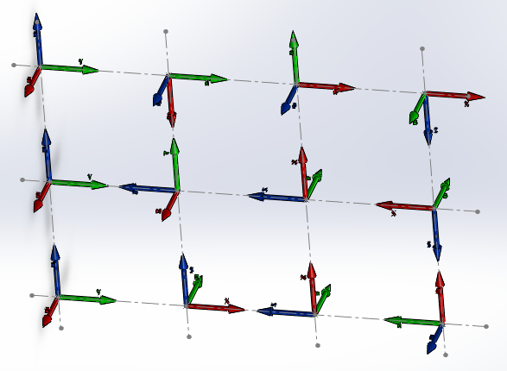
Combining Rotations
Now try to compute corresponding matrices…

Slide 90
Spin
When rotation of a rigid body is continuous, the problem may become quite complex.
A particular and easy situation is when the rotation axis $U$remains constant, while rotation angle $θ$ continuously varies at a constant rate
$$ω=\frac{dθ}{dt}=const$$
In this case rotation is called «spin» and is expressed by a vector
$Ω=ωU$
Namely, a vector in the direction of $U$ of amplitude $ω$ (NOT and axis + angle !!!)

Slide 91
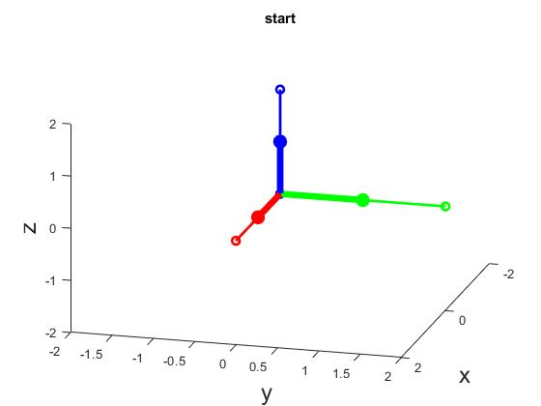
Esercizio 1
Tre rotazioni successive (NON angoli di Eulero):
90° intorno a Z
90° intorno a Y’
90° intorno a X’’
Trovare asse + angolo
?

Slide 92
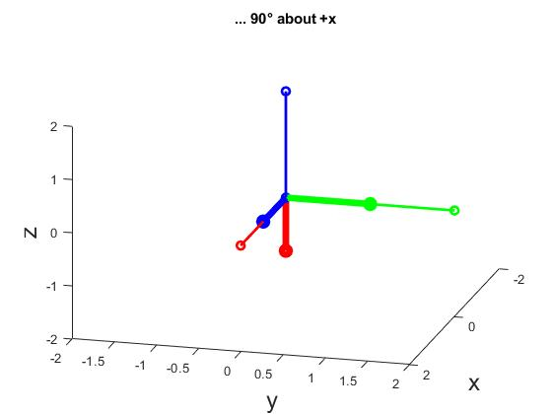
Soluzione 1

Slide 93
Esercizio 2
Tre rotazioni successive (NON angoli di Eulero):
90° intorno a Y
90° intorno a Z’
90° intorno a X’’
Trovare asse + angolo
?

Slide 94
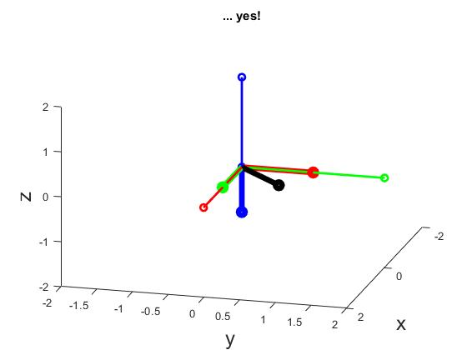
Soluzione 2

Slide 95
Passaggi 1) + 2):
Trovare asse + angolo
?

Slide 96
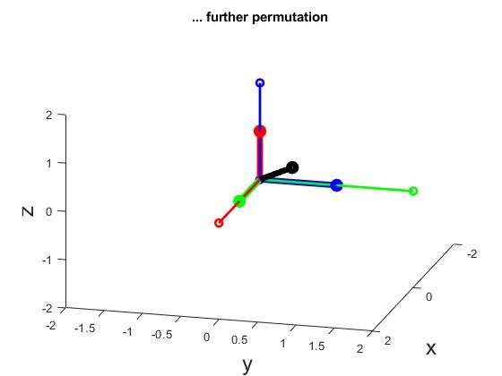
Soluzione
Angolo: 240°, -240° (480°) per la permutazione successiva

Slide 97
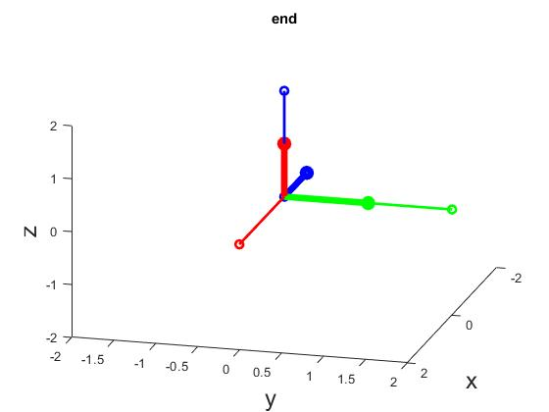
Esercizio 3
Trovare gli angoli di Eulero per la rotazione in figura:
Trovare asse + angolo
?

Slide 98
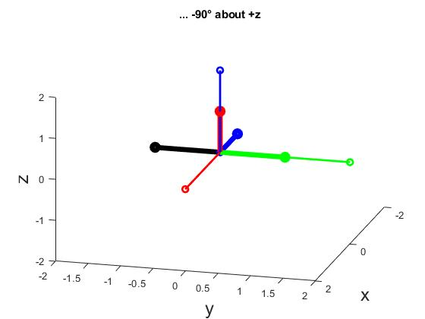
Soluzione 3
1) +90° intorno Z’’
2) +90 intorno X’
3) -90° intorno Z

Slide 99
Reference Frames
We will mostly use the following frames:
Sat-Centered Inertial (the reference)
$$F_{S}≜\left(\begin{matrix}\begin{matrix}1 & 0 & 0\end{matrix} \\ \begin{matrix}0 & 1 & 0\end{matrix} \\ \begin{matrix}0 & 0 & 1\end{matrix}\end{matrix}\right)$$
Body-Fixed
$$F_{B}$$
Target-Pointing
$$F_{T}$$

Slide 100
An Exercise - I
Given spacecraft COG located at longitude 35°, latitude 22°25’12" and altitude 600km above sea level (longitude from Vernal point)
Given mission pointing target on Earth at longitude 34°12’02", latitude 21°12’ (sea level)
Compute $Z$ axis of Target-Pointing Frame (from COG to target)
Compute $X$ axis of Target-Pointing Frame (orthogonal to $Z$ and parallel to equator)
Compute $Y$ axis of Target-Pointing Frame (ortogonal to both $X$ and $Z$)

Slide 101
Answers - I
TWO solutions:
$$XYZ′=\left(\begin{matrix}\begin{matrix}\text{0.698} & \text{−0.40}\text{8} & \text{−0.588}\end{matrix} \\ \begin{matrix}\text{−0.71}\text{6} & \text{−0.39}\text{8} & \text{−0.574}\end{matrix} \\ \begin{matrix}\text{0}\text{.000} & \text{0.82}\text{2} & \text{−0}\text{.5}\text{70}\end{matrix}\end{matrix}\right)$$
Alternatively
$$XYZ′=\left(\begin{matrix}\begin{matrix}\text{−0}\text{.698} & \text{0.408} & \text{−0}\text{.588}\end{matrix} \\ \begin{matrix}\text{0.716} & \text{0.398} & \text{−0}\text{.574}\end{matrix} \\ \begin{matrix}\text{0}\text{.000} & \text{−0}\text{.822} & \text{−0}\text{.570}\end{matrix}\end{matrix}\right)$$
Same Z. Opposite X and Y

Slide 102
An Exercise - II
Given spacecraft COG located at longitude 35°, latitude 22°25’12" and altitude 600km
Given mission pointing target in deep space at azimut 12°10’22" (w.r.t. Vernal point), elevation -15°10’ (w.r.t. equatore)
Compute $Z$ axis of Target-Pointing Frame (from COG to target)
Compute $X$ axis of Target-Pointing Frame (orthogonal to $Z$ and parallel to equatore)
Compute $Y$ axis of Target-Pointing Frame (ortogonal to both $X$ and $Z$)

Slide 103
Answers - II
TWO solutions:
$$XYZ′=\left(\begin{matrix}\begin{matrix}\text{0.}\text{211} & \text{−0.}\text{2}\text{56} & \text{0.}\text{943}\end{matrix} \\ \begin{matrix}\text{−0.}\text{9}\text{78} & \text{−0.}\text{0}\text{55} & \text{−0.}\text{204}\end{matrix} \\ \begin{matrix}\text{0}\text{.000} & \text{0.}\text{9}\text{65} & \text{−0.}\text{2}\text{61}\end{matrix}\end{matrix}\right)$$
Alternatively
$$XYZ′=\left(\begin{matrix}\begin{matrix}\text{−0}\text{.211} & \text{0.}\text{256} & \text{0.943}\end{matrix} \\ \begin{matrix}\text{0.}\text{978} & \text{0.}\text{055} & \text{−0}\text{.204}\end{matrix} \\ \begin{matrix}\text{0}\text{.000} & \text{−0}\text{.}\text{965} & \text{−0}\text{.}\text{261}\end{matrix}\end{matrix}\right)$$
Same Z. Opposite X and Y
Why TWO?

Slide 104
Comment to Exercise
Aim of your attitude control system shall be to rotate spacecraft such that its Body-Fixed Frame coincides with Target-Pointing Frame…
That is, find a rotation $R$ such that:
$$F_{T}=R∗F_{B}$$
Therefore:
$$F_{T}∗{F_{B}}^{−1}=R$$
GREAT!
Seems simple…
BUT

Slide 105
Comment to Exercise
Since $F_{T}$ is known (mission dependent), two questions arise:
How to measure $F_{B}$? ➔ Attitude Determination
How to rotate by $R$? ➔ Attitude Control

Slide 106
Attitude Determination
Aim of attitude determination system is to find the attitude $F_{B}$ of spacecraft at any given instant!
HOW?
Let’s try a simple experiment together…
We need a volunteer!

Slide 107
PART III
Attitude Sensors

Slide 108
Attitude Determination
The attitude $A$ of a spacecraft is defined as the ROTATION from
Spacecraft Centered Inertial Frame $F_{S}$ to
Body-Fixed Frame $F_{B}$
$F_{S}=\left(\begin{matrix}1 & 0 & 0 \\ 0 & 1 & 0 \\ 0 & 0 & 1\end{matrix}\right)$
to
$$F_{B}=\left(\begin{matrix}\begin{matrix}\text{0.21} & \text{−0.}\text{26} & \text{0.94}\end{matrix} \\ \begin{matrix}\text{−0.}\text{98} & \text{−0.}\text{05} & \text{−0.2}\end{matrix} \\ \begin{matrix}\text{0} & \text{0.}\text{96} & \text{−0.}\text{26}\end{matrix}\end{matrix}\right)$$

Slide 109
Attitude Determination
$$F_{S}=\left(\begin{matrix}1 & 0 & 0 \\ 0 & 1 & 0 \\ 0 & 0 & 1\end{matrix}\right)=I$$
$$F_{B}=A∗F_{S}=A∗I=A$$
$$A=F_{B}$$

Slide 110
Attitude Determination
The attitude of a spacecraft has three DOF!
So you need at least three independent oriented measurements, as orthogonal as possible. BUT…
The more measurements you have, the higher the accuracy
The more measurements you have, the higher is also the tolerance to faults
Let’s first have a look at the existing attitude sensors, then we will draw some consideration

Slide 111
Attitude Determination
What can you measure in a S/C for attitude?
Earth magnetic field (axis of magnetic field → 2 DOF; oriented)
Sun light (axis of luminous radiation → 2 DOF; oriented) – only during day 60-70% of time…
Ground station RF (axis of RF signal → 2 DOF; often UN-oriented) – only during TX
Star pattern (axis of pointing vector → 2 DOF; plus angle → 1 DOF)
Ground photos (axis of pointing vector → 2 DOF; plus angle → 1 DOF)

Slide 112
Spin Determination
What can you measure in a S/C for spin?
Spin can be determined in a blind manner (no external source is required) by means of gyroscopes
Alternatively, spin can be determined by time-derivative of attitude angle

Slide 113
Magnetometers
Different types:
Scalar (only measure total strength of field; not useful)
Vector (measure the component(s) of the magnetic field in one (or more) particular direction/s) → they measure magnetic field axis and its amplitude (not useful)

Slide 114
Vector Magnetometers
Different types:
Rotating Coil: magnetic field induces a sine wave in a rotating coil. Phase of sinewave indicates direction but only on a 2D plane. Obsolete and mechanically complex!
Hall Effect: produce a voltage proportional to the applied magnetic field along a 1D direction. Field strength must be large, therefore not always applicable

Slide 115
Vector Magnetometers
Magnetoresistive: thin strips of permalloy (NiFe magnetic film) whose electrical resistance varies with magnetic field.
They have a well-defined axis of sensitivity, can be produced in 3-D versions and can be mass-produced as an integrated circuit.
Response time of less than 1 microsecond and can be sampled up to 1,000 times/second.
Can have accuracy or 0.1°-1°

Slide 116
Vector Magnetometers
Fluxgate: a small, magnetically susceptible core wrapped by two coils of wire.
An alternating current is flown in one coil, driving the core through alternating saturation.
This field induces a voltage in the second coil, which is measured by a detector.
When the core is exposed to a magnetic field, it is more easily saturated in alignment with the field and less easily in opposition to it.
The alternating magnetic field and the induced voltage go out of phase w.r.t. input current.

Slide 117
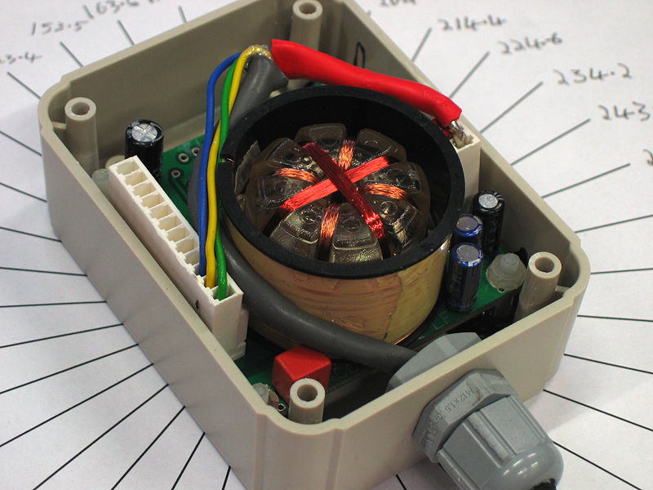
Fluxgate Sensor
By User:Zhatt - Own work, Public Domain, https://commons.wikimedia.org/w/index.php?curid=280053

Slide 118
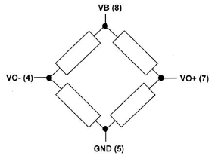
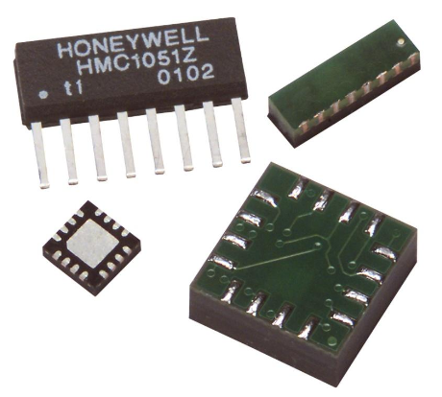
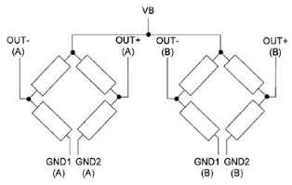
Magnetoresistive Sensor, Bridge
HMC1051/HMC1052L/HMC1053

Slide 119
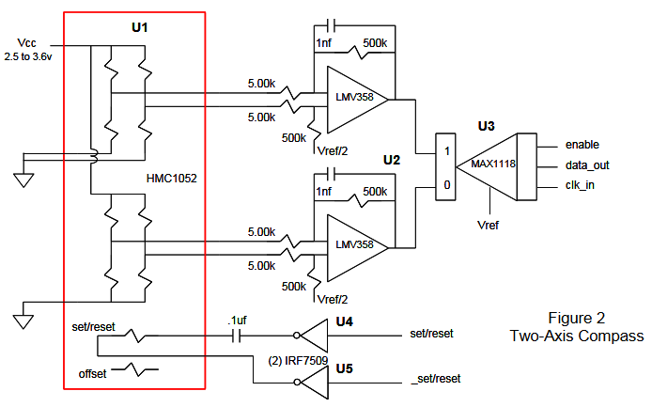
Magnetoresistive Sensor, Bridge

Slide 120
Magnetoresistive Sensor, Bridge
SET/RESET STRAP
The set/reset strap is spiral of metallization that couples to the sensor elements. Each set/reset strap has a resistance of a few ohms with a minimum required peak current of 400mA (pulses).
With rare exception, the set/reset strap must be used to periodically condition the magnetic domains of the magneto-resistive elements for best and reliable performance.
Periodical short pulses of high current

Slide 121
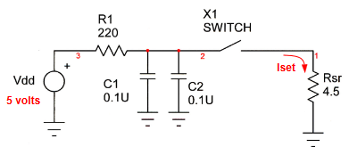
Magnetoresistive Sensor, Bridge

Slide 122
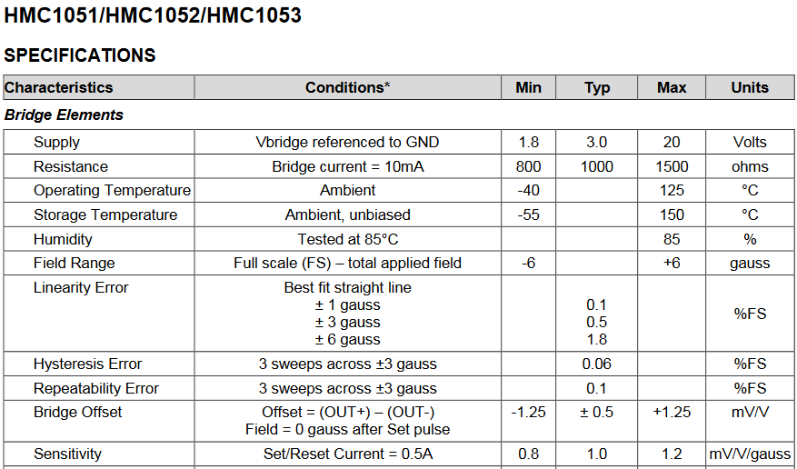
Magnetoresistive Sensor, Bridge

Slide 123
Magnetoresistive Sensor, Bridge
GROUND CALIBRATION is required!
SET/RESET in flight is required!
IN-FLIGHT CALIBRATION is required!

Slide 124
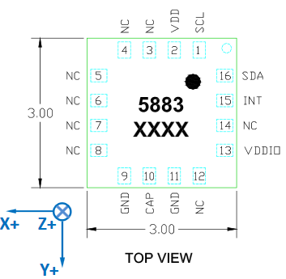
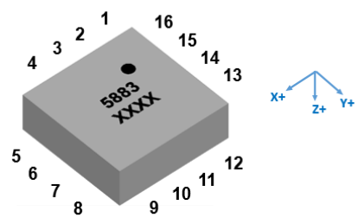
Magnetoresistive Sensor, I2C
MMC5883MA

Slide 125
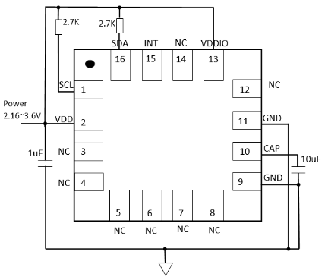
Magnetoresistive Sensor, I2C

Slide 126
Magnetoresistive Sensor, I2C

Slide 127
Magnetoresistive Sensor, I2C
Simpler circuit
More complex SW (configuration, readout, UART, etc.)
GROUND CALIBRATION is required!
SET/RESET in flight is required!
IN-FLIGHT CALIBRATION is required!
DIGITAL SYSTEM: may suffer from radiation-induced latchup (SEL) and upsets (SEU)

Slide 128
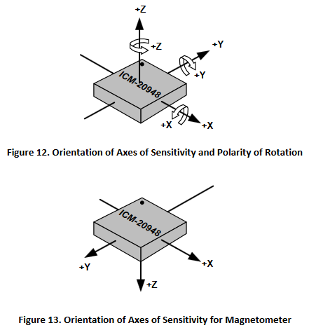
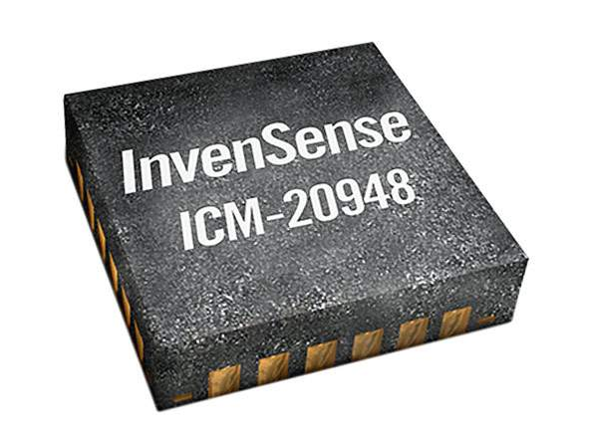
IMU (Magnetometer+Gyroscope)
ICM-20948

Slide 129
IMU (Magnetometer+Gyroscope)
ICM-20948

Slide 130
IMU (Magnetometer+Gyroscope)

Slide 131
IMU (Magnetometer+Gyroscope)

Slide 132
IMU (Magnetometer+Gyroscope)

Slide 133
IMU (Magnetometer+Gyroscope)
Very Simple circuit
Complex SW (configuration, readout, UART, etc.)
GROUND CALIBRATION is required!
IN-FLIGHT CALIBRATION is required!
DIGITAL SYSTEM: may suffer from radiation-induced latchup (SEL) and upsets (SEU)
NO FLIGHT HERITAGE

Slide 134
Sun and Star Sensors
Different types:
Solar 1D (scalar)
Solar 2D (axis, no angle)
Solar + Horizon 3D (axis + angle)
Star 3D (axis + angle)
Note that they ALL have to identify the so-called sun poiting vector $S$, which is by definition a unit-length vector pointing from satellite to the sun.
A unit-length vector only has two DOF, therefore two components are usually enough to define it.

Slide 135
Solar 1D sensor
Usually made of a single photodiode foreseen for high illuminance (up to 128 k lx = 1360W/m2)
In theory current generated by the photodiode is proportional to:
Cosine of incidence angle $\cos{θ}$ (variable)
Illuminance (constant = 128 k lx)
Sensor sensitive area (constant)
Sensor sensitivity (constant)
Therefore
$$I_{O}= K_{SS}\cos{θ}$$
With $K_{SS}$ being an appropriate constant

Slide 136
Solar 1D sensor
CPC1822

Slide 137
Solar 1D sensor
In theory output current is proportional to $\cos{θ}$, therefore to the $Z$ component $S_{Z}$ of sun pointing vector (suppose that $Z$ is the axis orthogonal to the sensor surface)
$$I_{O}=K_{SS}∗S_{Z}$$
In practice, sensor sensitivity is not uniform in all directions therefore output is not exactly proportional to $\cos{θ}$, therefore to $S_{Z}$
Must be compensated
real
$$\cos{θ}$$

Slide 138
Solar 1D sensor
Alternatively one can use a diffusing filter in front of the sensor
$$φ$$
FILTER
$$θ$$
$$φ\cos{θ}$$
SENSOR

Slide 139
Solar 2D sensor
Usually made of a pinhole in front of a camera.
Pinhole receives a spot of light which is offset (along $X$ and $Y$ coordinates) by an amount proportional to the $X$and $Y$ components of sun point vector $S$.
Solar 2D Sensor can either be:

Slide 140
Solar 2D sensor
Analog: a rectangular layer of photosensitive material which distributes current onto four electrodes at the four side of the sensor. Two currents (either single-ended or differential) provide $X$and $Y$ components of sun pointing vector $S$:
$$\begin{matrix}I_{X}=G_{X}∗S_{X} & & I_{Y}=G_{Y}∗S_{Y}\end{matrix}$$

Slide 141
Solar 2D sensor
Digital: a complete bitmap camera (either CMOS or CCD) which «takes a picture of the sun». A trivial piece of SW on a uC computes the X-Y coordinates of the sun center, which are a measure of the $X$and $Y$ components of sun pointing vector $S$:
$$\begin{matrix}X=G_{X}∗S_{X} & & Y=G_{Y}∗S_{Y}\end{matrix}$$

Slide 142
Other attitude sensors
RF Direction Of Arrival (DOA) sensors: an antenna array together with some RF phase measurement circuits.
It measures the direction of arrival of RF signals from ground station and computes the $X$and $Y$ components of ground-station pointing vector $Q$:
$$\begin{matrix}X=G_{X}∗Q_{X} & & Y=G_{Y}∗Q_{Y}\end{matrix}$$

Slide 143
Other attitude sensors
Star Sensor: a complete optical system made of a high aperture lens plus a bitmap camera (either CMOS or CCD) which takes a picture of the stars in the sky.
A non-trivial piece of SW on a uC identifies the most brilliant stars in the scene and locates them in a detailed sky map stored on-board.
Usually three to five stars are enough to locate their position in the sky map.

Slide 144
Other attitude sensors
SKY MAP
CAMERA

Slide 145
Other attitude sensors
A star sensor computes the X-Y coordinates of the star pointing vector $T$:
$$\begin{matrix}X=G_{X}∗T_{X} & & Y=G_{Y}∗T_{Y}\end{matrix}$$
In addition (it is the only sensor which can do it!) it computes the angle $θ$ of rotation around star pointing vector, deriving the angle from the rotation of the camera scene w.r.t. the sky map!

Slide 146
Summing Up…
All attitude sensors measure one or more components (e.g. $B_{X}$, $B_{Y}$, $B_{Z}$) of a given axis (either magnetic field $B$ or sun pointing $S$ or RF direction $Q$ or star direction $T$) w.r.t. the Body-Fixed Reference Frame $F_{B}$
Next step will be to merge all measurements together to retrieve some useful information out of them (not so easy, maybe…)
Are you sure???

Slide 147
Major Sources of Error
Most sensors suffer from one or more:
Gain (sensit.) Error
Gain Drift with temperature or aging
Offset
Offset Drift with temperature or aging
Misalignment (cross-axis)
Misalignment Drift (usually negligible)
Noise + INTERFERENCES!!!
Occasional Failures (e.g. SEL/SEU)
Permanent Failures (e.g. broken wire)
GROUND CALIBRATION
IN-FLIGHT CALIBRATION
SUPERVISION

Slide 148
Major Sources of Error
Gain Errors:
Transducer sensitivity
Conditioning Electronic tolerances
Perturbing external elements (e.g. metallic elements, reflecting surfaces)
Temperature drifts
Aging
Supply voltage sensitivity
TYPICAL VALUES: 1%-10%

Slide 149
Major Sources of Error
Offset Errors:
Transducer offset
Conditioning Electronic offset
Perturbing external elements (e.g. magnetic elements; e.g. magnetorquers with iron core!)
Temperature drifts
Aging
Supply voltage sensitivity
TYPICAL VALUES: +/- 5%-50% FS !!!

Slide 150
Major Sources of Error
Misalignments:
Transducer instrinsic misalignment
Perturbing external elements (e.g. metallic elements)
Assembly misalignment (+/- 0.2mm soldering tolerance over 10mm package width ➔ 5.7° )
TYPICAL VALUES: 1° - 10°

Slide 151
Major Sources of Error
INTERFERENCES. Just a few examples for magnetometers:
An unshielded power supply PCB track conducting 1A generates, at 5cm distance (half the size of a 1U CubeSat) a field of 0.04G = 4.000 nT = 10% of max Earth field!!!
If the distance is 1cm, the field is 0.2G !!!
A magnetorquer (suppose 0.2A in 200 coils of 8cm diameter) generates a field of 890,000 nT (15 times max Earth field!!!)
An iron screw close to magnetometer…

Slide 152
Homogeneous Sensor Fusion
Imagine a «real» situation…

Slide 153
Homogeneous Sensor Fusion
How can you combine all measurements from several HOMOGENEOUS sensors (e.g. all the magnetic)?
Remember that the more sensors you have, the safer is the system in case of failures!!!
… and individual errors tend to compensate!!!
But each sensor may have its own: Orientation, Misalignment, Gain, Offset…

Slide 154
Homogeneous Sensor Fusion
$$B$$
Given magnetic field $B$ expressed as a vector in the body-fixed frame $F_{B}$
Each $i$-th sensor will respond accordingly, providing ONE output $S_{i}$
Consider 2D/3D sensors as 2/3 independent $S_{i}$
For each sensor, its $S_{i}$ will depend on its orientation, alignment, gain, offset $O_{j}$, noise $n$:
$$S_{i}= G_{i}∗B+O_{i}+n$$
where
$$G_{j}=\left[\begin{matrix}G_{X,i} & G_{Y,i} & G_{Z,i}\end{matrix}\right]$$

Slide 155
Homogeneous Sensor Fusion
$$B$$
Each $G_{X,i}$ (respectively, $G_{Y,i}$ and $G_{Z,i}$) is the response of the sensor to a magnetic field oriented along $X$ (respectively, $Y$ and $Z$) axis in the body-fixed frame $F_{B}$
Therefore
$$S_{i}= G_{i}∗B+O_{i}+n$$
means:
$$S_{i}=G_{X,i}∗B_{X}+G_{Y,i}∗B_{Y}+G_{Z,i}∗B_{Z}+O_{j}$$

Slide 156
Homogeneous Sensor Fusion
By putting all $G_{i}$ and $O_{i}$ as rows of two matrices
$$\begin{matrix}G=\left[\begin{matrix}\begin{aligned}\begin{matrix}G_{X,1} & G_{Y,1} & G_{Z,1}\end{matrix} \\ G_{2}\end{aligned} \\ … \\ G_{N}\end{matrix}\right] & & O=\left[\begin{matrix}\begin{aligned}O_{1} \\ O_{2}\end{aligned} \\ … \\ O_{N}\end{matrix}\right]\end{matrix}$$
By multiplying, we get a column vector of the responses from all homogeneous sensors:
$$S=\left[\begin{matrix}\begin{aligned}S_{1} \\ S_{2}\end{aligned} \\ … \\ S_{N}\end{matrix}\right]=G∗B+O+n$$

Slide 157
Homogeneous Sensor Fusion
The problem is now:
If all $G$ and $O$ are known (reasonable)
Supposing noise $n$ random
Given the set of measured values $S_{M}$
What is the most likely value of $B$ ?
From
$$S=G∗B+O+n$$
If we neglect noise $n$, then
$$B=G^{−1}∗\left(S_{M}−O\right)$$

Slide 158
Homogeneous Sensor Fusion
When $G$is not square (more equations than unknowns) we use the «left division» or «pseudoinverse» instead. Either:
$$B=G \backslash \left(S_{M}−O\right)$$
$$B=G^{+}∗\left(S_{M}−O\right)$$
where \ is left division and $G^{+}$ is pseudo-inverse (SEE Wikipedia for definitions…)

Slide 159
Homogeneous Sensor Fusion
Since:
All $G$ and $O$ are known
Given the set of measured values $S_{M}$
Having found the most likely value of $B$
From
$$S=G∗B+O+n$$
In theory
$$S_{M}=S$$
But, due to error, noise, faults, one or more components might not match

Slide 160
Homogeneous Sensor Fusion
Try to identify qhat componet does not match and act accordingly (correct G, O or flag the sensor as faulty…)

Slide 161
Homogeneous Sensor Fusion

Slide 162
An Exercise - III
Imagine the small-sat in figure:
The top frame is Body-Fixed
Y axis is aligned with major diagonal
The other frames are the X-Y-Z coordinates of as many 3D magnetometers
The leftmost has X axis offset by 20 degrees w.r.t. sat X
Red is always X, Green is always Y, Blue is always Z

Slide 163
An Exercise - III
Suppose magnetometer sensitivity between 40000 and 50000 V/T (random)
Suppose offsets between -0.5V and + 0.5V (random)
Compute matrices $G$ and $O$
Suppose magnetic field of (-0.15, +0.02, 0.22) G
Compute expected sensor outputs $S_{E}$
Add noise with variance 0.05V to outputs
Given these values compute $B_{M}$ → compare

Slide 164
PART IV
Attitude Determination

Slide 165
Heterogeneous Sensor Fusion
Suppose a number of «axes» have been identified, from individual homogeneous sensor fusions. For instance:
$B_{M}$ is the measured magnetic field
$S_{M}$ is the measured sun pointing vector
$Q_{M}$ is the measured RF direction
Each of them may have a different reliability:
$λ_{B}$ is the reliability of magnetic measurement
$λ_{S}$ is the reliability of sun measurement
$λ_{Q}$ is the reliability of RF measurement

Slide 166
Heterogeneous Sensor Fusion
We have now to identify spacecraft attitude $F_{B}$ w.r.t. sat-centered inertial frame $F_{S}$:
$$F_{B}=R∗F_{S}$$

Slide 167
Heterogeneous Sensor Fusion
In practice, the measured «axes» in frame $F_{B}$

Slide 168
Heterogeneous Sensor Fusion
Are THE SAME PHISICAL PARAMETERS which exist in frame $F_{S}$

Slide 169
Heterogeneous Sensor Fusion
Except for the same (inverse) rotation $F_{S}$
RGB is sat
Black are measurements

Slide 170
Heterogeneous Sensor Fusion
Therefore inverse rotation $R^{−1}$ is the one which:
Rotates $F_{B}$ back into $F_{S}$
Rotates measured values back into real physical parameters

Slide 171
Heterogeneous Sensor Fusion
We must therefore know:
Real magnetic field $B_{S}$ in frame $F_{S}$:
Depends on orbit point (see part I)
Requires mathematical model of geomagnetic field (known, from the web)
Real sun pointing vector $S_{S}$ in frame $F_{S}$:
Requires well-known orbital parameters of sun (known, from astronomy)
Real RF pointing vector $Q_{S}$ in frame $F_{S}$:
Depends on orbit point (see part I)
Depends on location of ground station
Etc.

Slide 172
Heterogeneous Sensor Fusion
We have measured:
Estimated magnetic field $B_{B}$ in frame $F_{B}$ from sensor fusion
Estimated sun pointing vector $S_{B}$ in frame $F_{B}$ from sensor fusion
Estimated RF pointing vector $Q_{B}$ in frame $F_{B}$ from sensor fusion
Etc.

Slide 173
Heterogeneous Sensor Fusion
In theory, if:
$$F_{B}=R∗F_{S}=R$$
Then:
$$M_{B}=R^{−1}∗M_{S}$$
$$S_{B}=R^{−1}∗S_{S}$$
$$Q_{B}=R^{−1}∗Q_{S}$$
Therefore, in theory:
$$\left[\begin{matrix}M_{B} & S_{B} & Q_{B}\end{matrix}\right]=R^{−1}∗\left[\begin{matrix}M_{S} & S_{S} & Q_{S}\end{matrix}\right]$$
From which:
$$F_{B}=R=\left[\begin{matrix}M_{B} & S_{B} & Q_{B}\end{matrix}\right] \backslash \left[ \begin{matrix}M_{S} & S_{S} & Q_{S}\end{matrix}\right]$$

Slide 174
Heterogeneous Sensor Fusion
In practice, because of measurement errors the matrix R is not a mathematically correct rotation matrix!!!!.
We have to slightly modify the method…
Let’s try to identify two formally correct reference frames $Γ$ strongly related with the measured parameters ($Γ_{B}$) and the real physical parameters ($Γ_{S}$)
What is a formally correct reference frame ???
ORTHOGONAL and UNIT LENGTH

Slide 175
Heterogeneous Sensor Fusion
First axis of $Γ_{B}$: the more reliable measurement in frame $F_{B}$ (e.g. $M_{B}$) made with unit length:
$$X_{Γ_{B}}=\frac{M_{B}}{\left\|M_{B}\right\|}$$
First axis of $Γ_{S}$: the corresponding real physical value in frame $F_{S}$ (e.g. $M_{S}$) made with unit length:
$$X_{Γ_{S}}=\frac{M_{S}}{\left\|M_{S}\right\|}$$

Slide 176
Heterogeneous Sensor Fusion
Second axis of $Γ_{B}$: an axis orthogonal to the two measurements (for more than two it is slightly more complex) made with unit length:
$$Y_{Γ_{B}}=\frac{M_{B}×S_{B}}{\left\|M_{B}×S_{B}\right\|}$$
Second axis of $Γ_{S}$: the same in frame $F_{S}$:
$$Y_{Γ_{S}}=\frac{M_{S}×S_{S}}{\left\|M_{S}×S_{S}\right\|}$$

Slide 177
Heterogeneous Sensor Fusion
Third axis of $Γ_{B}$: must be orthogonal to the other axes and unit-length:
$$Z_{Γ_{B}}=X_{Γ_{B}}×Y_{Γ_{B}}$$
Third axis of $Γ_{S}$: the same in frame $F_{S}$:
$$Z_{Γ_{S}}=X_{Γ_{S}}×Y_{Γ_{BS}}$$

Slide 178
Heterogeneous Sensor Fusion
Now apply the formula found before to these formally correct frames:
$$F_{B}=Z_{Γ_{B}} \backslash Z_{Γ_{S}}$$
And the matrix turns out to be correct (proof omitted…)
As already said, if you have more than two physical parameters, the method is similar but a few additional steps are required (omitted here)

Slide 179
Heterogeneous Sensor Fusion
Partial conclusion:
We have been able to find spacecraft attitude $F_{B}$ !!!!
We can therefore estimate rotation $R$ to achieve desired mission target $F_{T}$
Now still the last step…

Slide 180
PART V
Attitude Actuators

Slide 181
Spin
When rotation of a rigid body is continuous, the problem may become quite complex.
A particular and easy situation is when the rotation axis $U$remains constant, while rotation angle $θ$ continuously varies at a constant rate
$$ω=\frac{dθ}{dt}=const$$
In this case rotation is called «spin» and is expressed by a vector
$Ω=ωU$
Namely, a vector in the direction of $U$ of amplitude $ω$ (NOT and axis + angle !!!)

Slide 182
Spin
Ω
By DF Malan - Own work, Public Domain, https://commons.wikimedia.org/w/index.php?curid=1354297

Slide 183
Axis + Angle
By DF Malan - Own work, Public Domain, https://commons.wikimedia.org/w/index.php?curid=1354297

Slide 184
Rotation by angle
θ
ω
Δω
-Δω

Slide 185
Attitude Actuators
Rotations around C.O.G. require a pair of identical forces, called torque C
$F−F=0$: no acceleration of C.O.G.
Torque $T=F ∗d$
F
d
F

Slide 186
Propulsion
Problem: we have to apply a $∆ω$. How ?
Newton’s laws applied to rotation:
Preservation of momentum: if $T=0$: $I∗Ω$ = const if $T=0$: $I_{1}Ω_{1}+I_{2}Ω_{2}+I_{3}Ω_{3}+$… = const if $T=0$: $I_{1}∆Ω_{1}+I_{2}∆Ω_{2}$ = 0
Torque Impulse: if we apply $T≠0$ for $t>0$: $I∗∆Ω=T∗t$

Slide 187
Attitude Actuators
A torque can be generated more easily than a single force! Three major techniques:
Mechanically, by using the principles of conservation of angular momentum (e.g. reaction or momentum wheels)
Magnetically, by using interaction between an internally generated magnetic field and the Earth magnetic field (magnetorquers)
By means of a pair of thrusters in opposite directions

Slide 188
Attitude Actuators
Rotations around C.O.G. require pairs of forces.

Slide 189
Momentum Actuators
A momentum actuator is based on the principles of preservation of the angular momentum.
In a closed system (a spacecraft) made of two parts (bus+payload and momentum actuator), the sum of angular momenta is constant.
Therefore
$$I_{1}ω_{1}+I_{2}ω_{2}=const$$
Or, equivalently
$$I_{1}{∆ω}_{1}+I_{2}∆ω_{2}=0$$

Slide 190
Momentum Actuators
Where
$$Iω$$
is the angular momentum of a body and is the product of its inertia tensor (matrix) $I$ and its angular velocity $ω$.
A reaction wheel generates internally an angular momentum $I_{2}{∆ω}_{2}$ by means of:
a motor spinning at speed $ω_{2}+{∆ω}_{2}$
a mass of inertia $I_{2}$

Slide 191
Momentum Actuators

Slide 192
Momentum Actuators
Consequently the spacecraft will acquire the opposite momentum
$$I_{1}{∆ω}_{1}=−I_{2}{∆ω}_{2}$$
Therefore a spin variation
$${∆ω}_{1}=−\left({I_{1}}^{−1}I_{2}\right){∆ω}_{2}$$

Slide 193
Momentum Actuators
Orbital manoeuvres:
Spining/despinning: the motor must maintain a given velocity $ω_{2}+{∆ω}_{2}$ to allow spacecraft to achieve a given ${∆ω}_{1}$. E.g. to despin from an initial spin $ω_{1}$ to 0, or from an initial null spin to a desired spin $ω_{1}$
Rotation: the motor must rotate a given additional angle ${∆θ}_{2}$ to rotate spacecraft by an angle ${∆θ}_{1}$. E.g. to aim to a desired target (required rotation $R$)

Slide 194
Momentum Actuators
Mind that if the motor was rotating at an initial velocity $ω_{2}$ this corresponds to an acceleration and deceleration ${±∆ω}_{2}$ for a given time ${∆θ}_{2}={∆ω}_{2}T$
Compensating external torques $T_{E}$ (e.g. solar pressure on non uniform lateral surfaces). This requires an acceleration $T_{E}=I_{1}\frac{dω_{1}}{dt}$ that is, an ever increasing angular acceleration which will soon drive motor/ wheel to saturate to its maximum speed!!!

Slide 195
Momentum Actuators
Advantages:
Very fast and easy to control
Drawbacks:
Motor shall continuously dissipate power to maintain its spin $ω_{2}$
Saturation: sooner or later the wheel saturates and requires desaturation (transfer of its angular momentum to another attitude actuator

Slide 196
Magnetic Actuators
A magnetic actuator is based on the magnetic interaction between an internally generated magnetic momentum $m$ and the Earth (or other planet) magnetic field $B$.
$$T=m×B$$
$T$ is perpendicular to both $m$ and $B$
$$\left|T\right|=\left|m\right|∗\left|B\right|∗\sin{θ}$$

Slide 197
Magnetic Actuators
A magnetic actuator can be made of either:
A magnet, having its constant momentum $m$ (trivial solution; cannot be controlled)
A flat solenoid
A cylindrical solenoid

Slide 198
Magnetic Actuators
Magnetic actuators can also be embedded inside other spacecraft systems

Slide 199
Magnetic Actuators
Magnetic momentum $m$ of a flat solenoid is given by:
$$m=N∗I∗A∗Z$$
where:
$N$ is number of turns
$I$ is solenoid current
$A$ is coil area
$Z$ is normal to coil

Slide 200
Momentum Actuators
Advantages:
Many manoeuvres require limited power
Can be used to desaturate reqction wheels
Drawbacks:
Slower than reaction wheels
Torque only perpendicular to the magnetic field. No torque parallel to it is achievable
Their control is more comples
Cannot be used in deep space or around plantes with no magnetic field

Slide 201
PART VI
Magnetic Attitude Control

Slide 202
Magnetic Attitude Control
How can we use magnetic actuators to generate either:
A given spin $ω$
A rotation matrix $R$
Since the achievable magnetic torque can only be orthogonal to magnetic field???

Slide 203
Magnetic Attitude Control

Slide 204
Magnetic Attitude Control
A few considerations:
Generic manoeuvres are not achievable magnetically unless one can allow enough time to complete them.
Only manoeuvres orthogonal to magnetic field can be implemented.
If you have them, angular manoeuvres ($∆θ$) are easier, faster and less power consuming with reaction wheels
If you have no reaction wheel, one shall accept longer manoeuvre time

Slide 205
Magnetic Attitude Control
Spin manoeuvres are better implemented with magnetorquers, unless they have to be fast
As a rule of thumb, generic manoeuvres require, in the worst case, from a quarter to half an orbit to be completed
The question is now: how to plan actuation commands along the orbit, to achieve a desired $∆ω$?
Angular manoeuvres are split into three phases: ($∆ω$ → rotation → $−∆ω$)

Slide 206
Magnetic Attitude Control
Magnetic actuators produce a torque $T$ which causes an angular acceleration:
$$T=I\frac{dω}{dt}$$
If we consider a short period $∆t$in which acceleration remains constant:
$$T∆t=I\frac{dω}{dt}∆t=I∆ω$$
We can split the manoeuvres time into a sequence of identical time intervals:
$$T_{1}∆t=I{∆ω}_{1}$$
$$T_{2}∆t=I{∆ω}_{2}$$
$$T_{3}∆t=I{∆ω}_{3}$$

Slide 207
Magnetic Attitude Control
Magnetic actuators produce a torque $T$ which causes an angular acceleration:
$$T=I\frac{dω}{dt}$$
If we consider a short period $∆t$in which acceleration remains constant:
$$T∆t=I\frac{dω}{dt}∆t=I∆ω$$
We can split the manoeuvres time into a sequence of identical time intervals:
$$T_{1}∆t=I{∆ω}_{1}$$
$$T_{2}∆t=I{∆ω}_{2}$$
$$T_{3}∆t=I{∆ω}_{3}$$

Slide 208
Magnetic Attitude Control
Tja
Tjb
T2b
T1b
T2a
T1a

Slide 209
Magnetic Attitude Control
Where
$${∆ω}_{1a}=∆tI^{−1}T_{1a}$$
$$T_{1a}=k_{1a}X_{1a}$$
$${∆ω}_{1a}=\left(∆tI^{−1}X_{1a}\right)k_{1a}=Ψ_{1a}k_{1a}$$
$${∆ω}_{1b}=Ψ_{1b}k_{1b}$$
$${∆ω}_{2a}=Ψ_{2a}k_{2a}$$
We can create a matrix
$$T_{1}∆t=I{∆ω}_{1}$$
$$T_{2}∆t=I{∆ω}_{2}$$
$$T_{3}∆t=I{∆ω}_{3}$$

Slide 210
Magnetic Attitude Control
The eigenvectors of the inertia matrix are called principal axes.
Let’s suppose now for simplicity that the principal axes are parallel to the body-fixed frame $F_{B}$, which is a simplified situation.
In this case inertial is a diagonal matrix
$$I_{1}=\left[\begin{aligned}\begin{matrix}I_{X} & 0 & 0\end{matrix} \\ \begin{matrix}0 & I_{Y} & 0\end{matrix} \\ \begin{matrix}0 & 0 & I_{Z}\end{matrix}\end{aligned}\right]$$

Slide 211
Energy for Attitude Determination
Spacecraft is spinning at rate ω (rad/s or PRM):
$$1 RPM= \frac{{360}^{o}}{60s}=\frac{2πrad}{60s}=0,105{rad}/s$$
If we sample attitude every $T_{s}$ (s), attitude angle varies by an angle
$$ω∗T_{s}$$
From one sample to the next one;
The indetermination of attitude angle due to sampling is therefore $ω∗T_{s}$

Slide 212
Energy for Attitude Determination
Each individual measurement requires a power $P_{M}$ for a minimum measurement time of $T_{M}$ therefore an energy of
$$E_{M}=P_{M}∗T_{M}$$
Acrtivating, measuring and deactivating an attitude sensor for the minimum measurement time $T_{M}$ at a rate of $F_{M}$ samples/s requires and average power of
$$P_{med}=E_{M}∗F_{M}$$

Slide 213
Energy for Attitude Control
xxx

Slide 214
Rotazione
Consumo
(%)
F(N)
v(m/s)
B
A
C
t(s)
acc
moto uniforme
dec
acc
moto uniforme
dec

Slide 215
Spostamento Rapido
Consumo
(%)
F(N)
v(m/s)
B
B
A
C
C
t(s)

Slide 216
PART VII
Attitude and Orbit Codetermination

Slide 217
PART VIII
POLITO-SATC achievements

Slide 218
ULTRA-THIN Reaction wheel
Notes:
Manca:
3d della ruota;
ipertesto performance.

Slide 219
ULTRA-THIN Reaction wheel
COTS (3.5” hard disk plate, low cost)
Ultra-thin (4.7-6 mm)
Light (165-190 g)
Flexible (larger/smaller scale)

Slide 220
AraMiS CubeSats - Aramis C1

Slide 221
AraMiS Missions – AraMiS – RW1

Slide 222
AraMiS Missions – AIM1 (telescope)
Exploded view
9cm reflector telescope

Slide 223
AraMiS Missions – AIM2 (LIBS)
Exploded view
LIBS (Laser-Induced Breakdown Spectrometer)

Slide 224
AraMiS Missions – multi-payload

