Slide 1
Design optimization of CubeSat telescopes and imagers for Earth and space observation
APSCO - 2019
Leonardo M. Reyneri
Politecnico di Torino

Slide 2
TERMINOLOGY

Slide 3
What is a Telescope ?
An optical instrument to see “far away” with a sufficient resolution within a sufficient field of view…

Slide 4
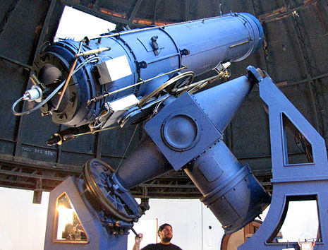
Zeiss-Gautier Ground Telescope

Slide 5
Space Telescope
A space telescope is an optical device made of four major elements:
The optical system (made of lenses and mirrors)
A mechanical structure
An optoelectronic detector (other detectors are ruled out in space!)
The target!

Slide 6
Reasons for Space Telescopes
No atmosphere! Therefore:
No light dispersion
No light pollution
No selective absorbance
No distorsion

Slide 7
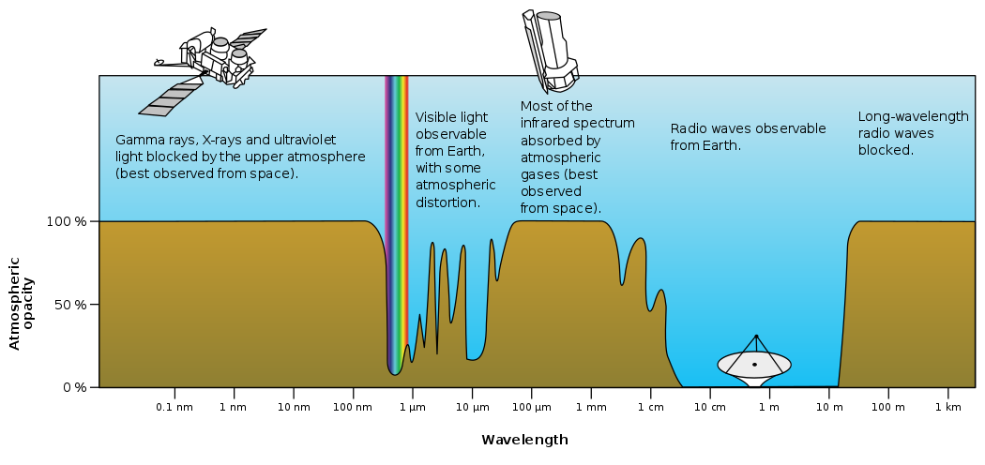
Reasons for Space Telescopes
Selective absorbance of atmosphere

Slide 8
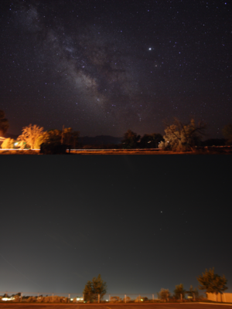
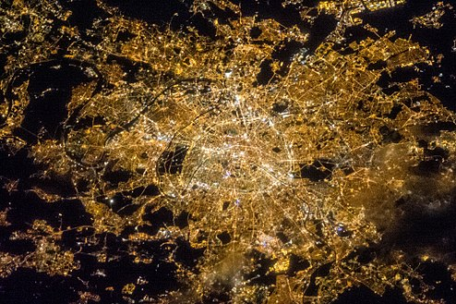
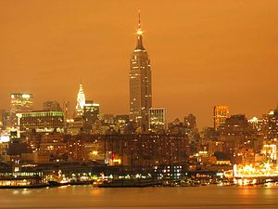
Reasons for Space Telescopes
Light pollution and dispersion
Small Village
Paris
City
New York

Slide 9
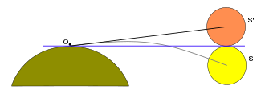
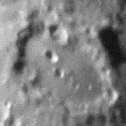
Reasons for Space Telescopes
Atmosphere refraction and distorsion
Moon

Slide 10
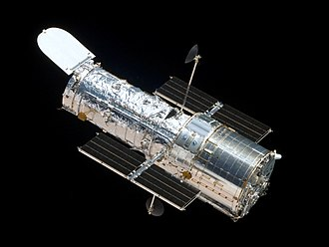
AraMiS Missions – AIM1 (telescope)
Hubble Space Telescope

Slide 11
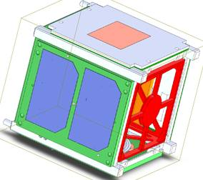
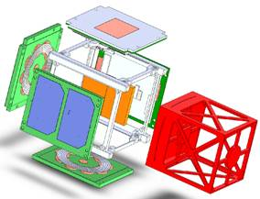
AraMiS Missions – AIM1 (telescope)
Exploded view
9cm reflector telescope

Slide 12
Field of View
The Field of view (FOV)
$$θ_{V}$$
is the open observable area a person can see through eyes or via an optical device.
In the case of optical devices and sensors, FOV describes the angle through which the telescope can pick up electromagnetic radiation (light).
FOV of human eye is about 210x150 deg

Slide 13
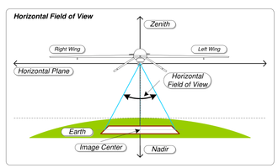
Field of View
$$θ_{V}$$
Field of View = ANGLE

Slide 14
Zenith and Nadir
The nadir is the direction pointing directly “below” a particular location; namely, one of the two vertical directions at a specified location.
In space, the concept of “being below” is vague → in astronomy the nadir is the direction of the force of gravity at a given location.
The direction opposite of the nadir is the zenith.
In deep space there is neither nadir nor zenith!

Slide 15
Zenith and Nadir

Slide 16
Zenith and Nadir
NADIR
ZENITH

Slide 17
Ground Footprint
Field of view (FOV) is an angle. That’s ok when talking about viewing stars or small bodies (e.g. a planet from far away).
When viewing at a larger celestial body (e.g. the Earth from an Earth orbit or the Moon from a Moon orbit), FOV spans an area on the ground called ground footprint.
$$D_{V}$$

Slide 18
Ground Footprint
Ground Footprint = AREA

Slide 19
Ground Footprint
Ground Footprint
(100km x 100km)
Field of View
(20° x 20°)

Slide 20
Telescope – Optical System
The optical system of a telescope is made of one or more lenses or mirrors placed at a certain, fixed distance from each other.
Three types:
Refracting, using only lenses
Reflecting, using only mirrors
Catadioptric, using both mirrors and lenses
Pinholes, using neither of them

Slide 21
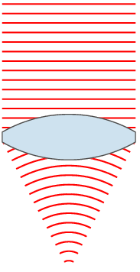
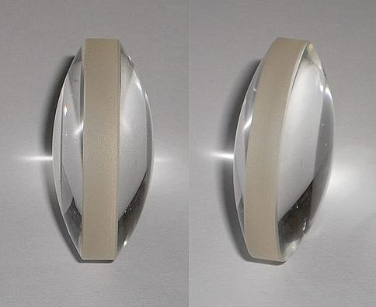
Refracting - Lens Principle

Slide 22
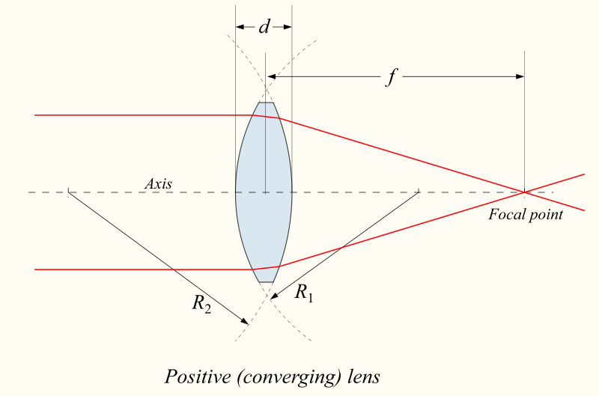
Lens Principle – Positive Lens
$$f>0$$
$$R_{2}>0$$
$$R_{1}>0$$

Slide 23
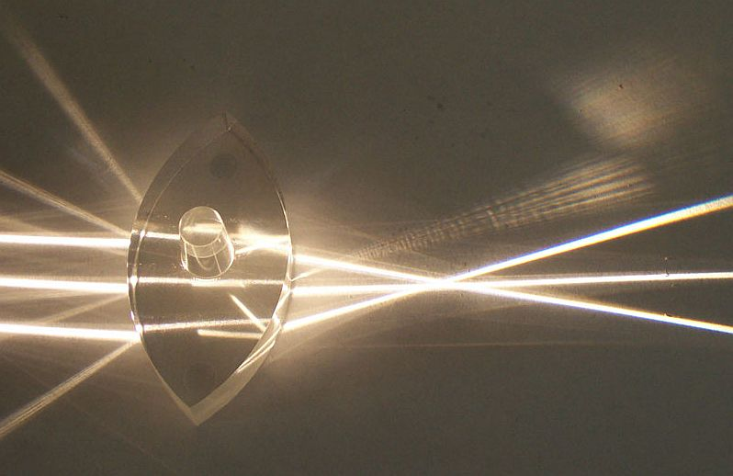
Lens Principle

Slide 24
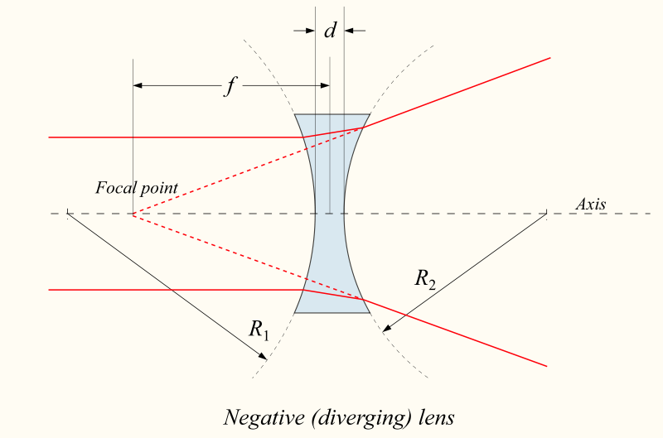
Lens Principle - Negative Lense
$$f<0$$
$$R_{2}<0$$
$$R_{1}<0$$

Slide 25
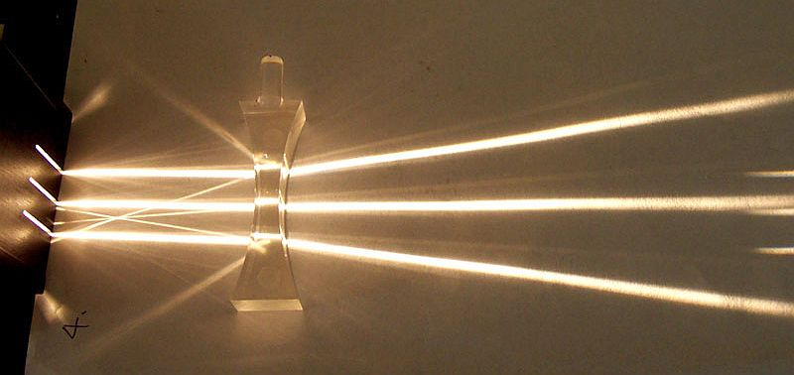
Lens Principle

Slide 26
Focal Length
In vacuum, glass lens ($n=1.52−1.62$):
$$\frac{1}{f}=\left(n−1\right)∗\left(\frac{1}{R_{1}}+\frac{1}{R_{2}}\left[−\frac{\left(n−1\right)d}{nR_{1}R_{2}}\right]\right)$$
In air ($n_{o}=\text{1.000277}$):
$$\frac{1}{f}=(n−n_{o})\left[\frac{1}{R_{1}}+\frac{1}{R_{2}}\left[−\frac{\left(n−n_{o}\right)d}{nR_{1}R_{2}}\right]\right]$$

Slide 27
Focal Length
An example:
$$R_{1}=R_{2}=25cm$$
$$d=1cm$$
$n=1,55$ (glass)
In vacuum ($n_{o}=\text{1}$):
$$f=\text{225}\text{,}\text{671}\text{mm}$$
In air ($n_{o}=\text{1.000277}$):
$f=\text{225}\text{,}\text{795}\text{mm}$ → $∆f=\text{124}μ\text{m}$ !!!

Slide 28
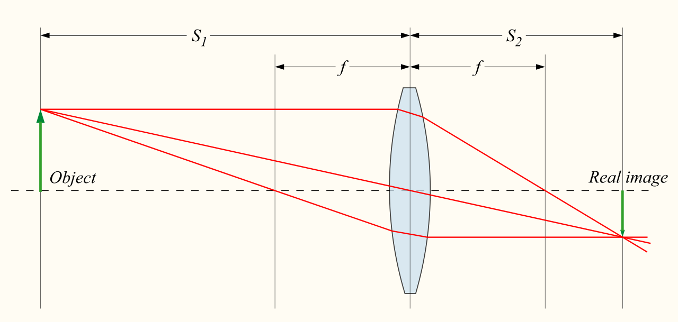
Lens operation – close distance
$$S_{1}$$
$$S_{2}$$
$$f$$
$$f$$
Lens center
Focal point
Target
Focal point
Real Image

Slide 29
Lens operation – variable distance
The relationship between target distance $S_{1}$, focal length $f$ and position of projected image $S_{2}$ is given by:
$$\frac{1}{S_{1}}+\frac{1}{S_{2}}=\frac{1}{f}$$
$S_{1}=S_{2}=2f$ → target and image same size
$S_{1}=∞$ → $S_{2}=f$ → target at infinity, image in focal plane

Slide 30
Lens operation – infinite distance
$$f$$
$$f$$
Focal plane
←$∞$
$$θ$$
←$∞$
Lens center
Focal point

Slide 31
Lens operation – infinite distance
$$f$$
$$f$$
Focal plane
Lens center
$$d$$
←$∞$
$$θ$$
$$θ$$
←$∞$
$d=f∗\operatorname{tg}{θ}≈f∗$ $θ$

Slide 32
Lens operation – infinite distance
Position on detector surface of targets located at infinite distance is proportional to incident light beam angle
$$d=f∗\operatorname{tg}{θ}≈f∗θ$$

Slide 33
Earth (Moon) images
$$D=H∗\operatorname{tg}{θ}$$
$$\operatorname{tg}{θ}=\frac{D}{H}=\frac{d}{f}$$
$$H$$
$$θ$$
$$d=\frac{f}{H}∗D$$
$$D$$

Slide 34
Sky images
$$θ$$
$$d=f∗\operatorname{tg}{θ}$$

Slide 35
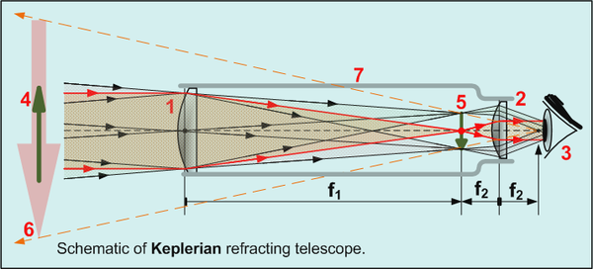
Refracting Telescope for eye

Slide 36
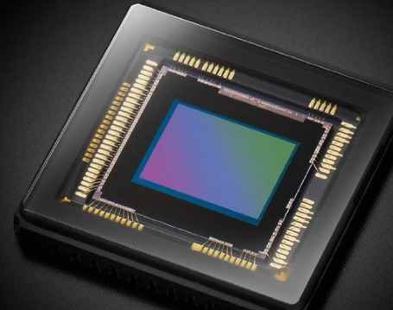
Refracting Telescope for space

Slide 37
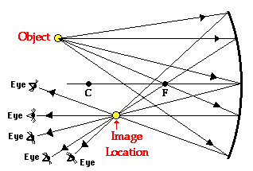
Reflecting – Mirror Principle

Slide 38
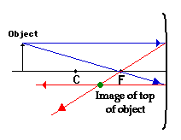
Reflecting – Mirror Principle

Slide 39
Focal Length
For a mirror, focal length is simple…
$$f= \frac{R}{2}$$

Slide 40
Mirror operation – variable distance
The relationship between target distance $S_{1}$, focal length $f$ and position of projected image $S_{2}$ is given by:
$$\frac{1}{S_{1}}+\frac{1}{S_{2}}=\frac{1}{f}$$
$S_{1}=S_{2}=2f$ → target and image same size
$S_{1}=∞$ → $S_{2}=f$ → target at infinity, image in focal plane

Slide 41
Optical Configurations
In principle, detector must be placed on focal plane.
Both lens/mirror and detector must be inside the same S/C
Focal length < largest S/C size !!!
There are though some optical configurations which allow to have longer focal lengths than S/C size. Most of them are for mirrors, but you can also use them with lenses

Slide 42
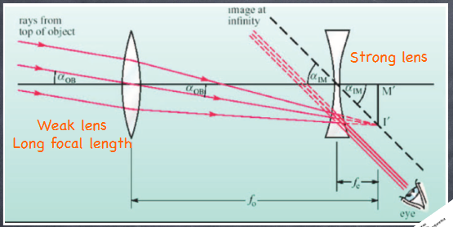
Optical Configurations
Galileo (only for human eye)

Slide 43
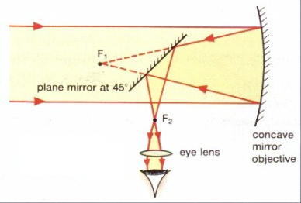
Optical Configurations
Reflecting
SPACECRAFT
DETECTOR

Slide 44
Optical Configurations
Gregory
SPACECRAFT
DETECTOR

Slide 45
Optical Configurations
Cassegrain
SPACECRAFT
DETECTOR

Slide 46
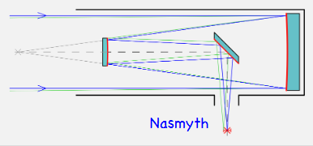
Optical Configurations
Gregory
SPACECRAFT
DETECTOR

Slide 47
Angular Resolution
Angular resolution $θ_{R}$ is (roughly) the smallest angular distance (in degrees or radians) between two bright points which allows to distinguish them from each other.
θ_{R}

Slide 48
Angular Resolution
Two points closer than the angular resolution are perceived as being a single (unfocused) point.
Angular resolution is usually measured at the nadir, as this is the direction offering the sharpest image.
θ_{R}

Slide 49
Ground Resolution
Ground resolution $D_{R}$ is (roughly) the smallest geometrical distance (in meters) between two bright points on the Earth (or Moon or any other planet) which allows to distinguish them from each other.
For a spacecraft orbiting at an altitude $H$, at the nadir:
$$D_{R}=H∗θ_{R}$$

Slide 50
Ground Resolution
$$D_{R}=H∗θ_{R}$$
$$H$$
$$θ_{R}$$
$$D_{R}$$

Slide 51
Two Resolutions ?
Angular resolution is adopted whenever there is no specific “distance” from the target, typically when the target is at the infinity. For instance when taking pictures of stars or planets.
Ground resolution is adopted whenever there is a specific distance from the target, typically when taking pictures of Earth or Moon or close by pictures of other planets. The distance is always measured at the zenith and coincides with the spacecraft orbiting altitude.

Slide 52
Resolution
$$θ_{R}$$
$$D_{R}$$

Slide 53
Relative Resolution
One can define the relative resolution as the ratio between the angular/ground resolution and the field-of-view/footprint:
$$R_{R}=\frac{θ_{R}}{θ_{V}}$$
$$R_{R}=\frac{D_{R}}{D_{V}}=\frac{H∗θ_{R}}{H∗θ_{V}}=\frac{θ_{R}}{θ_{V}}=R_{R}$$
which roughly represents how many useful “pixels” can be extracted along each direction of the image

Slide 54
Optical image size
The optical image size of a telescope represents the maximum number of useful pixels which can be extracted from an image provided with an ideal detector.
For a telescope with a rectangular FOV
$$θ_{Vx}×θ_{Vy}$$
optical image size is given by
$$\frac{θ_{Vx}}{θ_{R}}×\frac{θ_{Vy}}{θ_{R}}=\frac{1}{R_{Rx}}×\frac{1}{R_{Ry}}$$

Slide 55
Elements Affecting Resolution
Resolution (both angular and ground) depend on:
Lens/mirror diameter
Resolution of the detector (number of pixels)
Focusing
Aberrations
Wavelength
Spin

Slide 56
Lens/mirror Diameter
Diffraction is an optical phenomenon which takes place whenever light encounters an obstruction.
In particular when it encounters the input aperture of the telescope (or the diaphragm, if any)

Slide 57
Diffraction
AIRY DISK
AIRY DISK

Slide 58
Resolution due to Diffraction
AIRY DISK
$$\sin{{\text{θ}}_{R}}≈1.22\frac{λ}{D}$$
D
$${\text{θ}}_{R}$$
$${\text{θ}}_{R}≈1.22\frac{λ}{D}$$

Slide 59
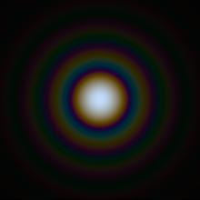
Diffraction
AIRY DISK
$${\text{θ}}_{R}=f(λ)$$
D
COLOURED!

Slide 60
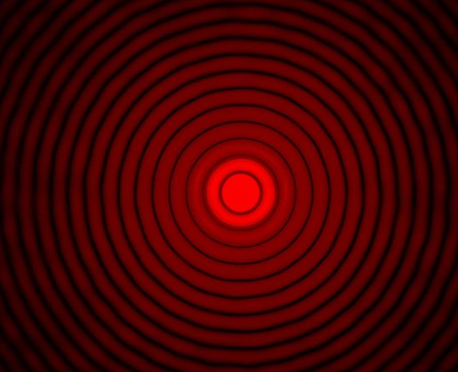
Small pinholes
AIRY DISK
$${\text{θ}}_{R}≈1.22\frac{λ}{D}$$
D
$$D=90µm$$

Slide 61
Detector Resolution
A “continuous” image on the focal plane is spatially sampled by an optoelectronic detector made of a large number of regularly spaced “pixels” (e.g. 512x512 pixels)

Slide 62
Detector Resolution
$$f$$
Focal plane
←$∞$
$$θ$$
←$∞$
Lens center

Slide 63
Detector Resolution
Focal plane
«Continuous» image

Slide 64
Detector Resolution
Focal plane
$d≈f∗$ $θ$
$$θ_{R}≈\frac{p}{f}$$
$$f$$
$$θ_{R}$$
Lens center
$$θ_{R}$$
←$∞$
$$p$$
←$∞$
←$∞$

Slide 65
Focusing
What happens if detector is not perfectly on the focal plane ?
We talk about unfocusing

Slide 66
Focusing
Focal plane
$$f$$
←$∞$
$$D$$
Detector
Detector
$$d:D=u:f$$
$$d$$

Slide 67
Focusing
$$d=\frac{Du}{f}$$
$$θ_{R}≈\frac{d}{f}=\frac{Du}{f^{2}}$$
$$d:D=u:f$$
Focal plane
$$f$$
$$D$$
Detector
$$θ_{R}$$
$$d$$

Slide 68
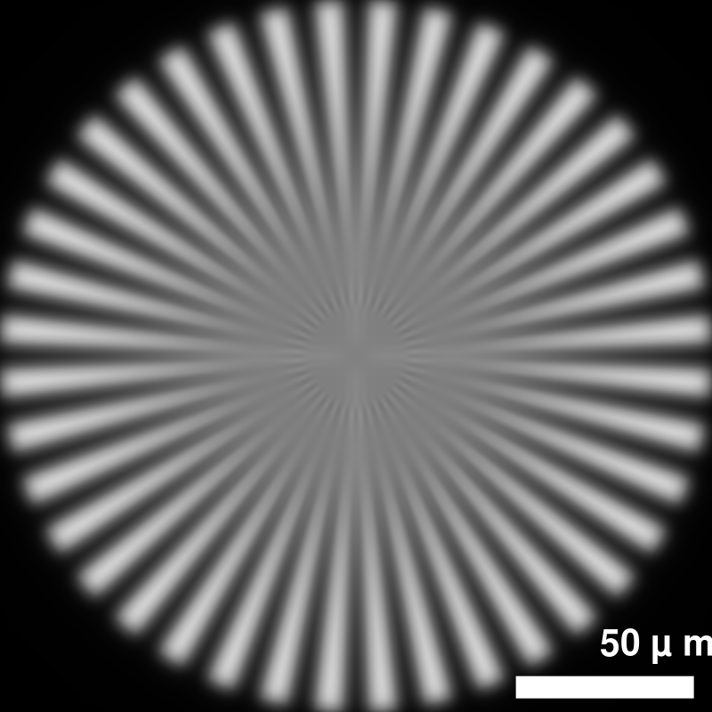
Focusing

Slide 69
Wavelength
Wavelength affects:
Refraction index of glass (only for lenses), therefore focal length
Diffraction

Slide 70
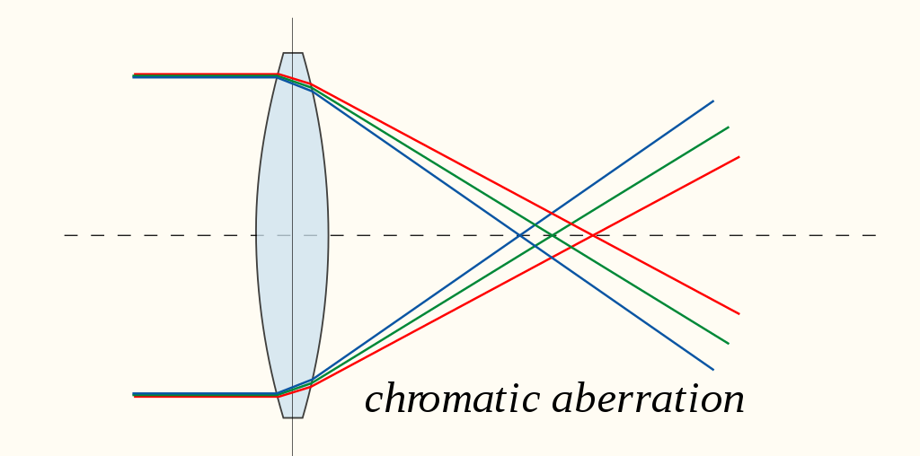
Cromatic Aberration

Slide 71
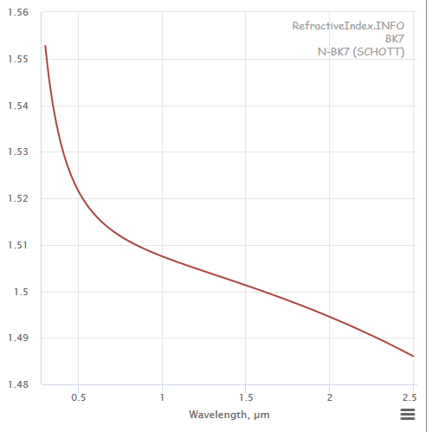
Cromatic Aberration
Refraction index of glass
$$f∝\frac{1}{\left(n−1\right)}$$
blue
$$n=1.527$$
green
$$n=1.521$$
$$∆f≈f\frac{∆n}{\left(n−1\right)}$$
red
$$n=1.516$$
$$θ_{R}=\frac{D∆f}{f^{2}}≈\frac{D}{f}\frac{∆n}{\left(n−1\right)}$$
Like unfocusing

Slide 72
Spin
Telescope spin $ω$ drifts image over detector during aperture time $T_{A}$ by an angle $∆θ$ which blurs the image impacting resolution by the same amount
$$θ_{R}=∆θ=ω∗T_{A}$$

Slide 73
Aberrations
In optics, aberration is a property of optical systems such as lenses that causes light to be spread out over some region of space rather than focused to a point.
Aberrations cause the image formed by a lens to be blurred or distorted, with the nature of the distortion depending on the type of aberration.

Slide 74
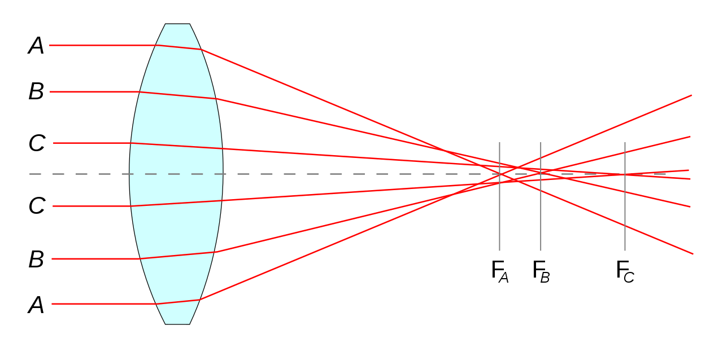
Spherical Aberration in lenses
«Focal» plane

Slide 75
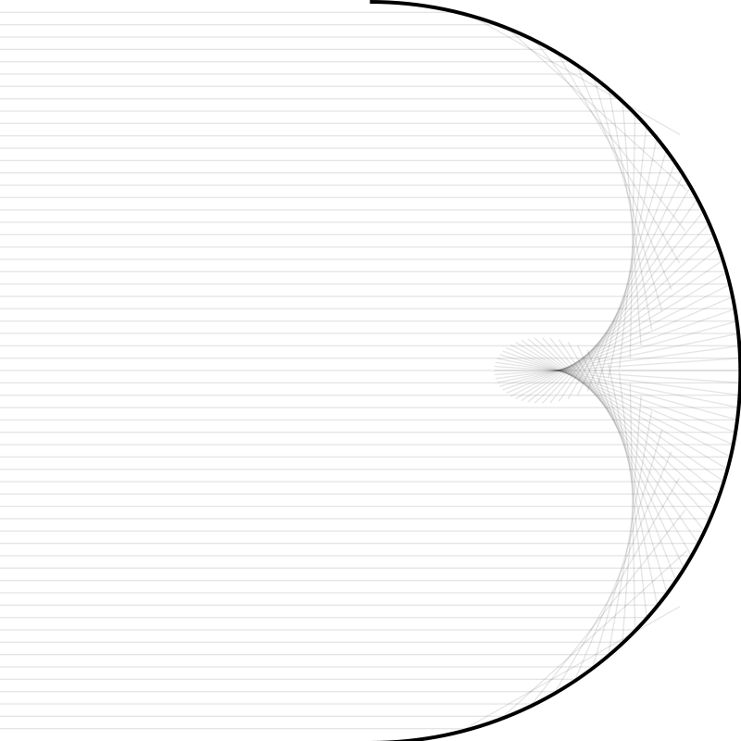
Spherical Aberration in mirrors
«Focal» plane

Slide 76
Spherical Aberrations
Spherical Aberration in lenses is:
proportional to fourth power of diameter
inversely proportional to third power of focal length
Function of refraction index of glass
Solutions:
Aspherical lens/mirror
Combination of positive and negative lenses/mirrors

Slide 77
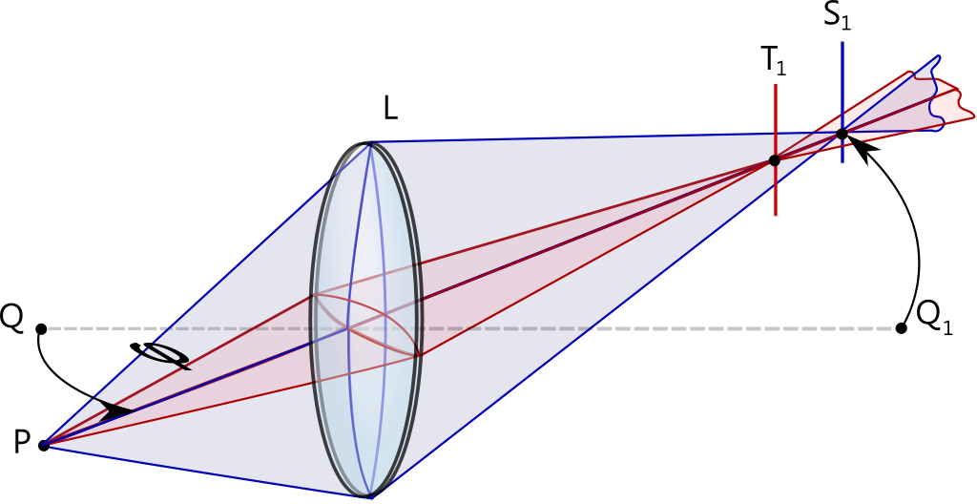
Astigmatism

Slide 78
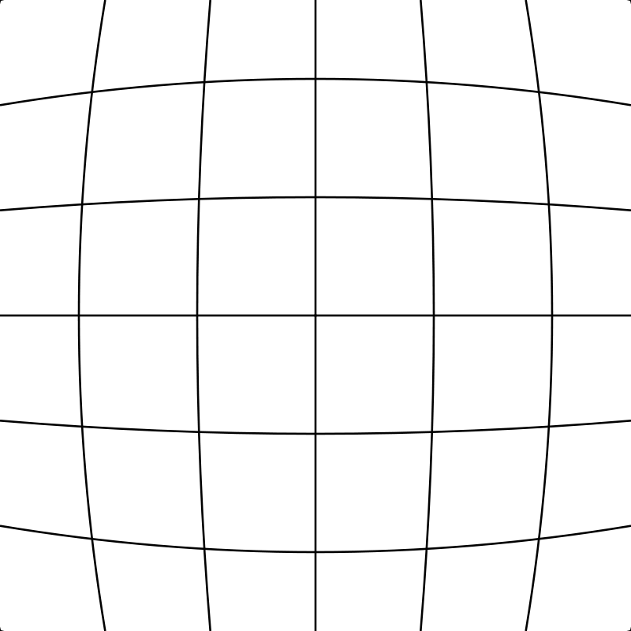
Distorsion

Slide 79
Elements Affecting Resolution
Field of View: $θ_{V}≈\frac{D_{S}}{f}$
Diffraction ${\text{θ}}_{R}≈1.22\frac{λ}{D_{L}}$
Detector resolution: $θ_{R}≈\frac{P_{S}}{f}$
Unfocusing: $θ_{R}≈\frac{Du}{f^{2}}$
Cromatic: $θ_{R}≈\frac{∆n}{n−1}$
Spin: $θ_{R}≈ω∗T_{A}$
Other Aberrations… $θ_{R}=a(…)$

Slide 80
Relative Resolution & Image Size
Resuming:
$$\frac{1}{R_{R}}=\frac{θ_{V}}{θ_{R}}==\frac{\frac{D_{S}}{f}}{1.22\frac{λ}{D_{L}}+\frac{P_{S}}{f}+\frac{Du}{f^{2}}+\frac{D}{f}\frac{∆n}{n−1}+ωT_{A}+a(…)}$$
$$\frac{1}{R_{R}}=\frac{θ_{V}}{θ_{R}}==\frac{D_{S}}{1.22\frac{fλ}{D_{L}}+P_{S}+\frac{Du}{f}+D\frac{∆n}{n−1}+fωT_{A}fa(…)}$$

Slide 81
Example I
$D_{S}=1cm$ (detector, 512x512 -> $P_{S}=20μm$
$f=10cm$
$λ=500nm$ (blue)
$D_{L}=30mm$
$u=0.2mm$
$\frac{∆n}{n−1}=0,0115$
$ω=0,01RPM; T_{A}=100ms$
$a≈0$
$$\frac{1}{R_{R}}=\frac{10mm}{2.03μm+19.5μm+60μm+345μm+10μm}$$
Limited by chromatic/unfocusing!

Slide 82
Telescope – Mechanical Structure
Mechanical structure has to:
Keep lenses/mirrors/detector in the right position
Protect optical system against dust
Protect optical system during vibrations
And MUST:
Keep focusing within less than 100µm (TBD) after vibration and over all temperature range
Keep lens/mirror/detector alignment

Slide 83
Telescope – Optical Detector
A space telescope is an optical device made of four major elements:
The optical system (made of lenses and mirrors)
A mechanical structure
An optoelectronic detector (other detectors are ruled out!)
The target!

